Slide 1
INSPIRE Summer Project: Making Machine Learning Interpretable By: Jessica Kim Mentor : Dr. Ryan Urbanowicz
Notes:
Make sure first few slides grab attention of reader (think of it as an essay)
Fix title of slides to avoid confusion and vagueness for any reader
Structure slides in a way where it’s like a funnel
Headliner: My Project: Making Machine Learning Interpretable & Understandable Using SHAP
What is Machine Learning?
Prevailing Challenge in ML:
Making Machine Learning models easy to interpret & understand
Importance :
Breaking down how complex algorithms make its predictions from the data it’s given
Goals & importance of the project
My project focuses on the issue of interpretability when it comes to predictions made my machine learning models
Provide any user who uses my code a better understanding of why it’s important to explain predictions made by machine learning models
What it means for biomedical data
Introduce STREAMLINE & how it addresses transparency through rigorous ML modeling and analysis
Explaining my code & why it’s application in STREAMLINE is important
Restructure Closer look slides (and rename to avoid confusion)
SHAP force plots should be talked about with summary figures
Diagram of saving shap FI values should also be included after the slide with that information
Create ’Acknowledgements’ and ‘Resources’ slides
Section about for-loops should serve as additional resources/supplemental material

Slide 2
Acknowledgments
This project is the one I can confidently and proudly call an achievement. I have struggled with my career path and thanks to this, I may have found a new interest to pursue. Even though the code I’ve created may be unfinished, I’ve invested a great deal of effort to put out my best work for what little real coding experience I’ve had.
I’d love to express my deepest appreciation to my mentor, Dr. Ryan Urbanowicz, for guiding me patiently through this project, fully knowing I’m new to this field and have little experience. I would also like to extend my warmest thanks to my mentor’s colleagues for helping me out when I came to them for questions. Lastly, I’m extremely grateful the those in charge of the INSPIRE Program for accepting me into this wonderful program and believed in my abilities based on my academic background.
It has been such a privilege to work under a prestigious healthcare organization that continues to be a leader in R&D for the industry. This research project has been a fulfilling, learning experience that I will continue to carry with me wherever I go.

Slide 3
Basic Idea About My Project
WHAT?
Breaking down how simple AND complex Machine Learning algorithms make its predictions from the data it’s given
WHY?
Addressing a well-known challenging issue in Machine Learning → Being able to interpret the results/predictions!
WHO?
Making it easy for any person to interpret & understand how Machine Learning models make predictions using software called SHAP

Slide 4
Basic Idea About My Project (cont.)
HOW?
Using feature importance software called SHAP to understand how each trained model from STREAMLINE made its predictions
SHAP software integrates Shapley Values
A method from cooperative game theory called ‘Shapley Values’ that tells us the distribution of contributions from each feature
AKA…How to fairly distribute the contribution of each feature from the final prediction
Curious to know more?....

Slide 5
Get to know Machine Learning!
What is Machine Learning (ML)?
Coined by Arthur Samuel in 1959
“Field of study that gives computers the ability to learn without being explicitly programmed.” – Arthur Samuel
Subset of Artificial Intelligence in Computer Science
‘Ability to learn’ using data/historical data, computational methods, & statistical techniques
ML learning process much similar to human brains gains knowledge
Using ML algorithms to create ML models using data and through continuous training
Notes:
https://www.geeksforgeeks.org/introduction-machine-learning/
https://www.geeksforgeeks.org/ml-machine-learning/
Urbanowicz, R. (2022, June 28). What is Machine Learning? Demystifying Methods and Application | Cedars-Sinai [Video]. Youtube. https://www.youtube.com/watch?v=MhK2Jz36T5o&list=PLafPhSv1OSDdG2v8K2EsXPd0V7TTQVnT9

Slide 6
Get to know Machine Learning! (cont.)
Common Challenges in Biomedical Data Analysis
Cleaning & data processing
Bad/noisy/sparse/biased data
Missing data values
Feature engineering (ensuring model works with features)
Analysis
Covariate adjustment
Imbalanced classification outcome
Computing
Scale of data (# features, # instances)

Slide 7
Get to know Machine Learning! (cont.)
Common Challenges in Biomedical Data Analysis (cont.)
Signal detection
Noise (meaningless data)
Missing predictive values
Rare variation
Complex multivariate associations (2+ dependent variables)
Reliability
Interpretability
Reproducibility
Identify & account for sources of bias

Slide 8
Get to know Machine Learning! (cont.)
Goals of ML
Discover patterns and associations within the data
Represent and apply those patterns as useful generalizations
Produce a model that can make predictions with a level of accuracy
Application: ML Goals Using Biomedical/Clinical Data
Identify risk factors & biomarkers of health outcomes
Personalized medicine
Diagnosis → Outcome prediction
Develop prediction models for deployment
Improve clinical efficiency
Speed & cost

Slide 9
Get to know Machine Learning! (cont.)
How ML works (general idea)
Learns from Experience (E) for given Task (T) measured by Performance (P)
Performance of Tasks improves with Experience
Example:
Experience: Dataset of emails considered ‘spam’ and ‘not spam’
Task: Recognize and classify email as ‘spam’ or ‘not spam’
Performance: Percentage of correctly classified emails
4 types of ML
Supervised/ Unsupervised Learning
Reinforcement Learning
Semi-Supervised Learning
Notes:
https://www.geeksforgeeks.org/introduction-machine-learning/
https://www.geeksforgeeks.org/ml-machine-learning/

Slide 10
Checkpoint!
Now you have a general idea of what Machine Learning is, what it achieves, and why it’s important in healthcare
But you’re now wondering ‘what is STREAMLINE’ and ‘how/why is it relevant in this presentation’
Let’s continue! →
Notes:
https://www.geeksforgeeks.org/introduction-machine-learning/
https://www.geeksforgeeks.org/ml-machine-learning/

Slide 11

About STREAMLINE
STREAMLINE?
“Simple Transparent End-to-End Automated Machine Learning Pipeline”
A software developed by Dr. Ryan Urbanowicz (my mentor) and his colleagues
An automated machine learning pipeline that performs rigorous, comprehensive analysis for data mining & predictive modeling

Slide 12
About STREAMLINE (cont.)
Goals & Importance
Provide a transparent framework to learn from data
Implement standard of ‘good practice’ of ML modeling and analysis
Identify & compare the strengths and weaknesses of ML modeling algorithms or other AutoML algorithms
User-friendly to all with or without coding experience
What you get out of STREAMLINE
Comprehensive comparison analysis of datasets, ML algorithms, and AutoML tools
Generated analysis/summarization of:
Complex feature interactions
ML modeling performance
[Improve] interpretability of ML model predictions
Urbanowicz, R., & Zhang, R.(2022). STREAMLINE: A Simple, Transparent, End-To-End Automated Machine Learning Pipeline. GitHub. Retrieved from https://github.com/UrbsLab/STREAMLINE/.

Slide 13
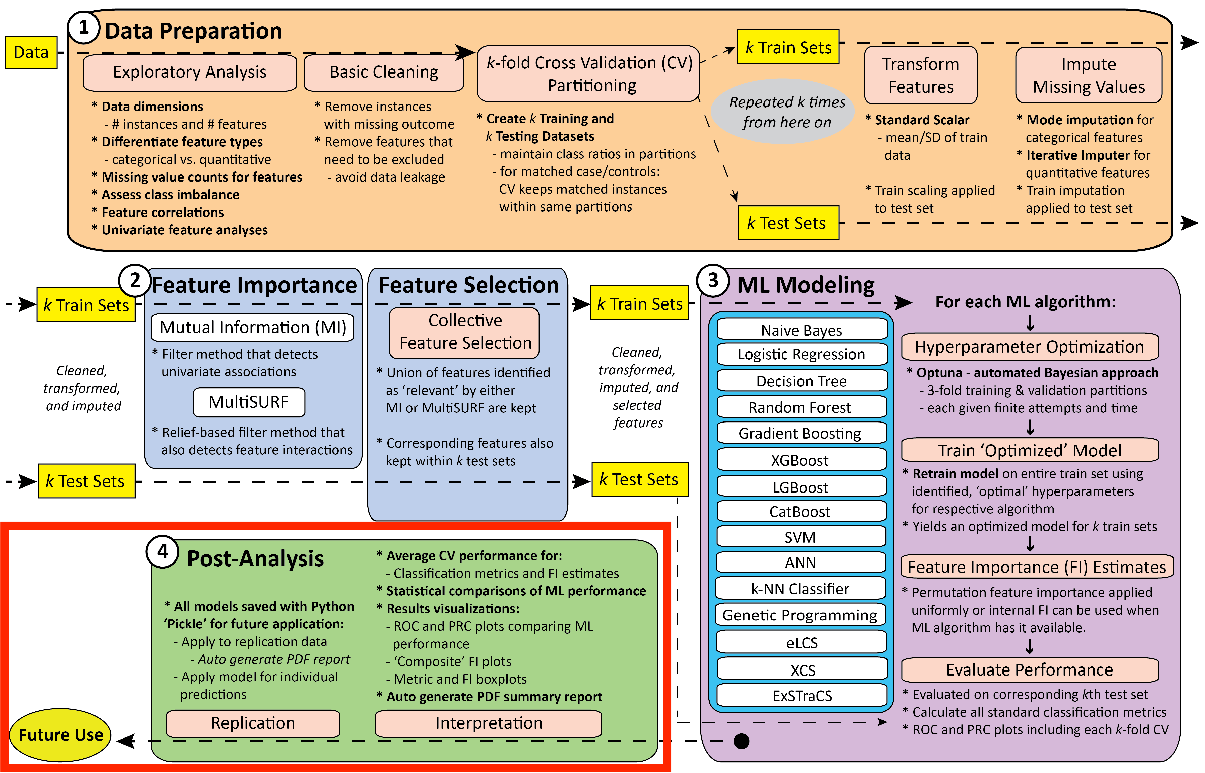
STREAMLINE Schematic
This project will mainly focus in this phase of the STREAMLINE pipeline →

Slide 14
About STREAMLINE (cont.)
How is Step 4: Post-Analysis important in this presentation?
Interpretability of model predictions remains a challenge in the industry
Easy to interpret results from simple ML models
Interpretability becomes increasingly difficult with more complex models such as neural networks
Urbanowicz, R., & Zhang, R.(2022). STREAMLINE: A Simple, Transparent, End-To-End Automated Machine Learning Pipeline. GitHub. Retrieved from https://github.com/UrbsLab/STREAMLINE/.

Slide 15
About STREAMLINE (cont.)
How is Step 4: Post-Analysis important in this presentation? (cont.)
We are concerned with how we can easily understand the prediction results of trained ML models from the pipeline
Project will be working with datasets and model objects saved from running STREAMLINE
Urbanowicz, R., & Zhang, R.(2022). STREAMLINE: A Simple, Transparent, End-To-End Automated Machine Learning Pipeline. GitHub. Retrieved from https://github.com/UrbsLab/STREAMLINE/.

Slide 16
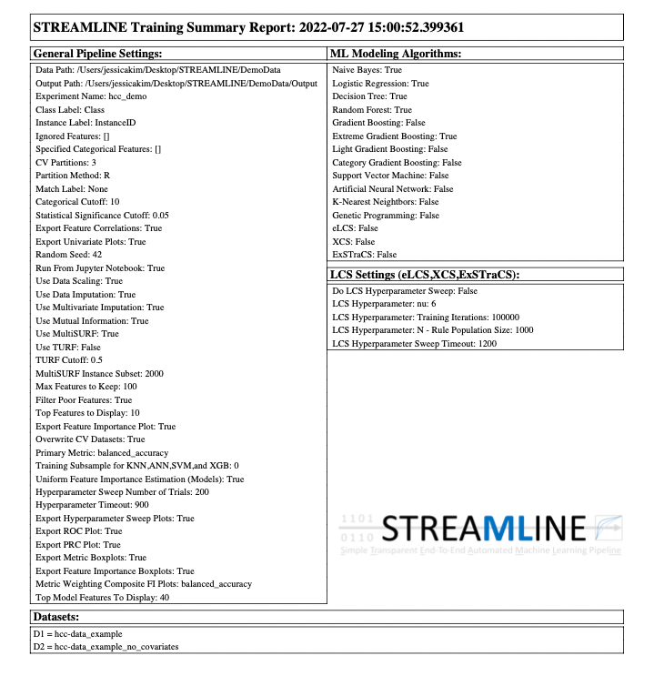
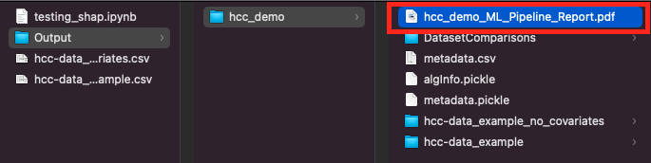
About Streamline: Sample Output from Running Code
In your computer’s local files, the STREAMLINE provides a PDF report of the whole pipeline results from each phase

Slide 17
Checkpoint!
Now you have an understanding of both Machine Learning, STREAMLINE, and which phase of STREAMLINE this project focuses on
Recall that I mentioned I would be a software called ‘SHAP’ which is based off of the cooperative game theory, Shapley Values.
Let’s look a little more into that before we get into the project. →

Slide 18
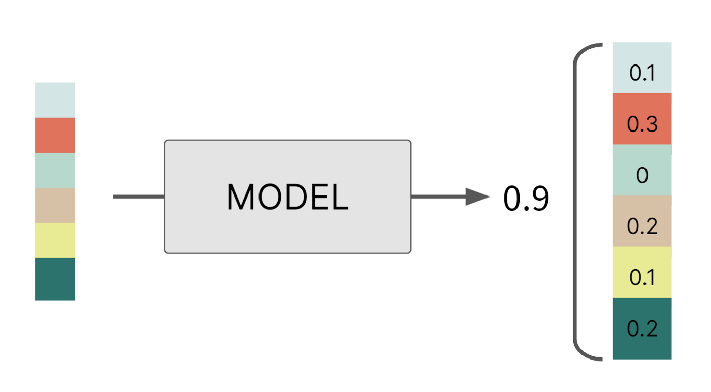
About Shapley Values
Shapley Values
Coined after Lloyd Shapley
Based on cooperative game theory (1951)
Idea → marginal contribution of each player to the final prediction/outcome
Tells us the IMPACT of each feature/player involved in a prediction
AKA…how much each feature MOVES the prediction AWAY from the AVERAGE PREDICTION OF ALL FEATURES
(Gopinath, 2021)
Notes:
https://towardsdatascience.com/the-shapley-value-for-ml-models-f1100bff78d1
https://christophm.github.io/interpretable-ml-book/shapley.html

Slide 19
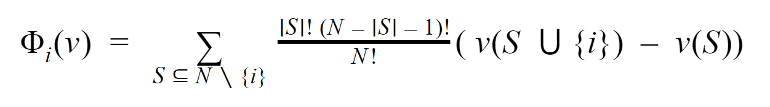
About Shapley Values: How It’s Calculated
(Gopinath, 2021)
Understanding the formula
Φ (Phi): measure of association of two binary variables (classification)
S: coalition/subset of players (combination of features with & without player i)
N: total number of players
i: player (feature values of the instance at contribute to the gain)
v: real-value payoff of the prediction from the features involved
Notes:
https://christophm.github.io/interpretable-ml-book/shapley.html
https://towardsdatascience.com/the-shapley-value-for-ml-models-f1100bff78d1

Slide 20
About Shapley Values: How It’s Calculated (cont.)
(Gopinath, 2021)
Calculating Shapley Values
Calculated by computing a weighted average of each feature across all coalitions (feature combinations)
Compares marginal contribution (Shapley value) of each feature to the model's overall predicted score
Notes:
https://christophm.github.io/interpretable-ml-book/shapley.html
https://towardsdatascience.com/the-shapley-value-for-ml-models-f1100bff78d1

Slide 21
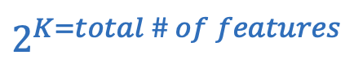
About Shapley Values: How It’s Calculated (cont.)
(Gopinath, 2021)
“Shapley value is calculated by computing a weighted average payoff gain that player i provides when included in all coalitions that exclude i.” – Divya Gopinath
Computational time for Shapley values increases exponentially for every feature
→
Notes:
https://christophm.github.io/interpretable-ml-book/shapley.html
https://towardsdatascience.com/the-shapley-value-for-ml-models-f1100bff78d1

Slide 22
About Shapley Values: Understanding the 4 Principles
4 Principles of Shapley Values
Efficiency
Feature contributions must add up to the difference of prediction for ‘x’ and the average
All Shapley values calculated for each feature should be the sum of the predicted value of the model output/prediction
Symmetry
Contribution values of two interchangeable features should be equal regardless of feature name
Simply…Feature names should not change the contributions of the model’s prediction
Notes:
https://christophm.github.io/interpretable-ml-book/shapley.html
https://towardsdatascience.com/the-shapley-value-for-ml-models-f1100bff78d1

Slide 23
Shapley Values: Understanding the 4 Principles (cont.)
Dummy
Missing features added to any coalition should be given a Shapley Value of 0.0
Should not impact the model’s output prediction
Additivity
Shapley value for each coalition is averaged over ‘n’ coalitions in the model → averaged out to get the Shapley value of the feature for that one model
Notes:
https://christophm.github.io/interpretable-ml-book/shapley.html
Lundberg, S., & Lee, S.-I. (2017). A Unified Approach to Interpreting Model Predictions. Retrieved from doi:10.48550/ARXIV.1705.07874.

Slide 24
Shapley Values: Advantages & Disadvantages
Advantages
Value is fairly distributed among all features
Long computational time
Why? → computes all permutations to give results
Allows contrastive prediction
Allows comparison/contrast of subset & average prediction instead of just a prediction to the average prediction of the entire dataset
Can even applied to a single data point
Disadvantages
Computationally expensive
Can EASILY be misinterpreted
Always uses ALL features
Not a good model for only explaining few features (SHAP can do this)
Does NOT work with features that are HIGHLY CORRELATED
Those features must be removed when selecting features
Notes:
https://christophm.github.io/interpretable-ml-book/shapley.html
https://towardsdatascience.com/the-shapley-value-for-ml-models-f1100bff78d1
Lundberg, S., & Lee, S.-I. (2017). A Unified Approach to Interpreting Model Predictions. Retrieved form doi:10.48550/ARXIV.1705.07874

Slide 25
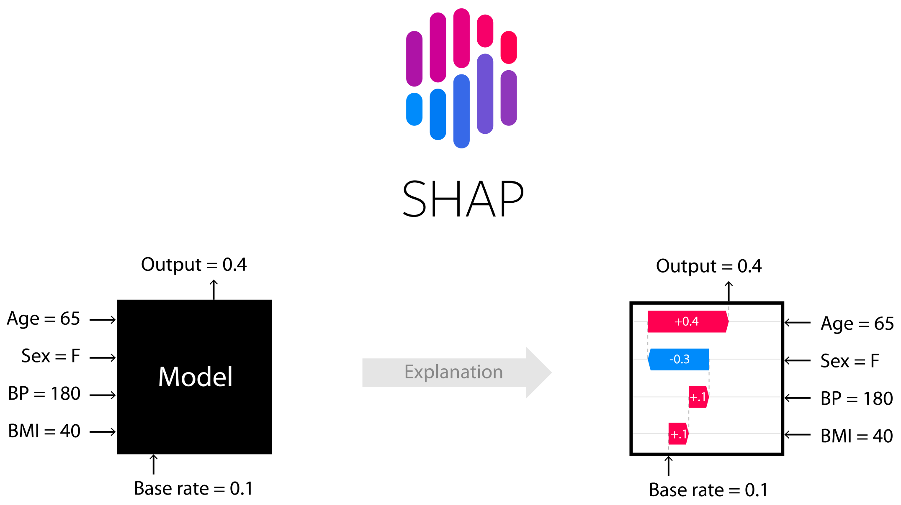
SHapley Additive exPlanations
(Lundberg, 2022)
Notes:
Codebase & README: Lundberg, S. (2022). SHAP. GitHub. https://github.com/slundberg/shap/blob/master/README.md
Paper: Lundberg, S., & Lee, S.-I. (2017). A Unified Approach to Interpreting Model Predictions. Retrieved from doi:10.48550/ARXIV.1705.07874.
* Turning complex black box models into interpretable/explainable ML models

Slide 26
About SHAP
Who created SHAP software?
Scott. M Lundberg
Senior Researcher at Microsoft research
Su-In Lee
Associate Professor, Paul G. Allen School of Computer Science & Engineering
Associate Professor, Department of Genome Sciences
Adjunct Associate Professor, Department of Electrical Engineering
Adjunct Associate Professor, Department of Biomedical Informatics and Medical Education University of Washington, Seattle
Notes:
https://sites.google.com/a/cs.washington.edu/suinlee/about-the-pi – Lee Lab website
https://scottlundberg.com/ - scott m lundberg profile

Slide 27
About SHAP: What is SHAP? (cont.)
What is ‘SHAP’?
A unified framework that serves as a measure of feature importance using the original ML model as the explanation object itself
AKA → Using an ML model to explain its own predictions (pretty cool right?)
An adaptation of Shapley Values but provides both local and global interpretability
Local → explain individual predictions
Global → holistic explanation of how the ML model behaves (ex. distributing data)
Global
Local
Local
Local
Local
Local
Local

Slide 28
About SHAP: Goals
Global
Local
Goals
Address long-standing issue of ML interpretability in ML models
Correct interpretation of a prediction model’s output helps establish:
Trust
Improve computational method performance
Support understanding of model predictions/behavior
Local
Local
Local
Local
Local
Notes:
Lundberg, S., & Lee, S.-I. (2017). A Unified Approach to Interpreting Model Predictions. Retrieved form doi:10.48550/ARXIV.1705.07874

Slide 29
About SHAP: Recall 4 Principles of Shapley Values
Recall 4 principles of Shapley Values
Efficiency
Calculated Shapley values for each feature should be the SUM of the predicted value of the model output/prediction
Symmetry
Feature names should not change the contributions values to the model’s prediction
Dummy
Missing features added to any coalition should be given a Shapley Value of 0.0
Additivity
Shapley value for each coalition is averaged over ‘n’ coalitions in the model → averaged out to get the Shapley value of the feature for that one model
Notes:
Lundberg, S., & Lee, S.-I. (2017). A Unified Approach to Interpreting Model Predictions. Retrieved form doi:10.48550/ARXIV.1705.07874

Slide 30
About SHAP: 3 Properties of SHAP
3 Properties of SHAP
Local Accuracy
Satisfies Efficiency property of Shapley Values
Missingness
Missing feature gets an attribution value of of zero
In theory, the missing feature could have an arbitrary value without hurting the local accuracy but this is ONLY relevant to features that are CONSTANT
Satisfies ‘Dummy’ principle → missing features should not impact the model
Notes:
Lundberg, S., & Lee, S.-I. (2017). A Unified Approach to Interpreting Model Predictions. Retrieved form doi:10.48550/ARXIV.1705.07874

Slide 31
About SHAP: 3 Properties of SHAP (cont.)
3 Properties of SHAP (cont.)
Consistency
When a feature that has higher impact in model A compared to model B, the feature importance value of model A should always remain larger than model B regardless of changes in the models
Feature importance value of a model increases or remains the same when the contribution value of a feature also increases or remains the same
Notes:
Lundberg, S., & Lee, S.-I. (2017). A Unified Approach to Interpreting Model Predictions. Retrieved form doi:10.48550/ARXIV.1705.07874

Slide 32
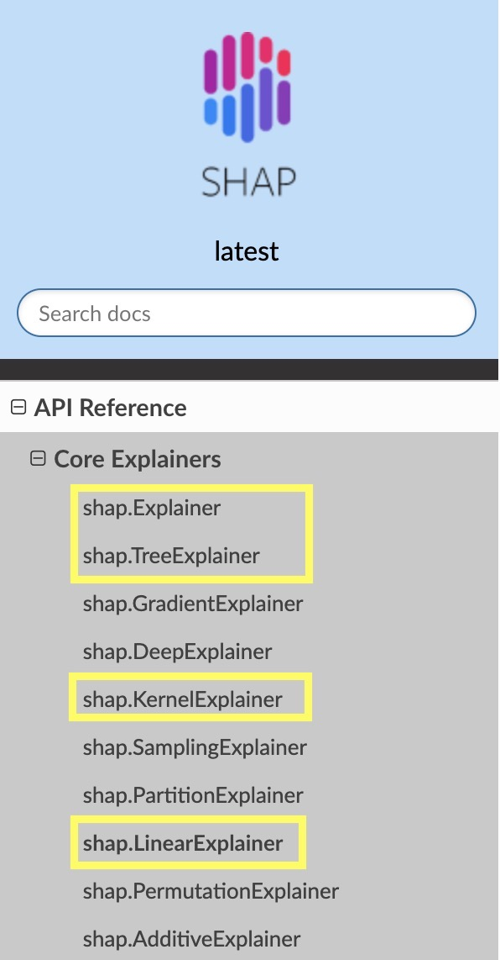
About SHAP: What are ‘Explainers’?
What is an Explainer?
Explainer is a function call
Takes in a model object and if necessary, background data, to build an ‘Explainer object’
Computes Shapley estimation algorithm for the model that was passed in
Notice
There different explainers that can be used to focus on specific criterions or ones that are designed for specific models
Notes:
Codebase & README: Lundberg, S. (2022). SHAP. GitHub. https://github.com/slundberg/shap/blob/master/README.md
Paper: Lundberg, S., & Lee, S.-I. (2017). A Unified Approach to Interpreting Model Predictions. Retrieved from doi:10.48550/ARXIV.1705.07874.
Turning complex black box models into interpretable/explainable ML models
https://shap.readthedocs.io/en/latest/generated/shap.Explainer.html

Slide 33
About SHAP: What are ‘Explainers’?
Examples of calling Explainers
shap.Explainer
explainer = shap.Explainer(model, X_train)
shap.TreeExplainer
explainer = shap.TreeExplainer(tree_model)
shap.GradientExplainer
explainer = shap.GradientExplainer( (model.layers[7].input, model.layers[-1].output), map2layer(preprocess_input(X.copy()), 7), local_smoothing=100)
DON’T WORRY!
Only the highlighted Explainers are mainly used in this project
Notes:
Codebase & README: Lundberg, S. (2022). SHAP. GitHub. https://github.com/slundberg/shap/blob/master/README.md
Paper: Lundberg, S., & Lee, S.-I. (2017). A Unified Approach to Interpreting Model Predictions. Retrieved from doi:10.48550/ARXIV.1705.07874.
Turning complex black box models into interpretable/explainable ML models
https://shap.readthedocs.io/en/latest/generated/shap.Explainer.html

Slide 34
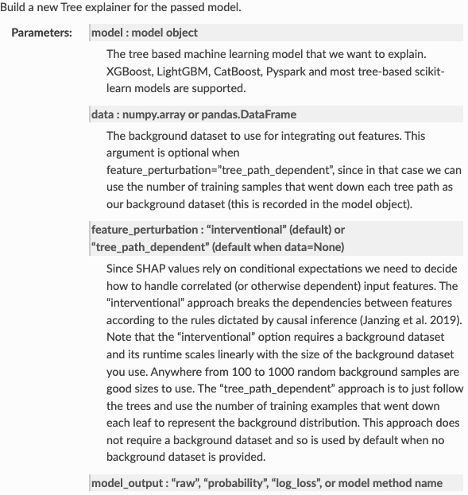
About SHAP: What are ‘Explainers’?
ALL SHAP Explainers have default parameters but the informational pages, such as the image provided, go in-depth about how users can customize specific parameters to generate outputs to focus on feature interactions
Notes:
Codebase & README: Lundberg, S. (2022). SHAP. GitHub. https://github.com/slundberg/shap/blob/master/README.md
Paper: Lundberg, S., & Lee, S.-I. (2017). A Unified Approach to Interpreting Model Predictions. Retrieved from doi:10.48550/ARXIV.1705.07874.
Turning complex black box models into interpretable/explainable ML models
https://shap.readthedocs.io/en/latest/generated/shap.Explainer.html

Slide 35
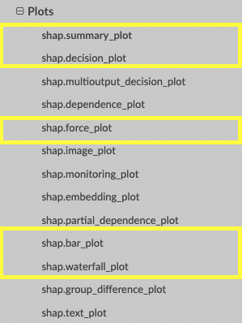
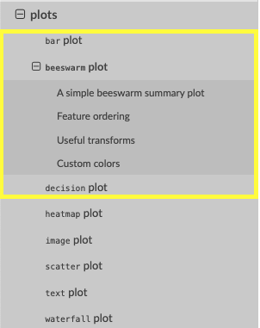
About SHAP: SHAP Plots
What are SHAP plots?
Function calls to create summary figure visualizations of feature importance using SHAP values for a given model
Some plots are made specifically for certain Explainer objects for a certain ML model
Tree-based models (Decision Tree, Random Forest, etc) may not work for waterfall plots
Changes to SHAP package may affect implementation of some plot function calls
Notes:
Codebase & README: Lundberg, S. (2022). SHAP. GitHub. https://github.com/slundberg/shap/blob/master/README.md
Paper: Lundberg, S., & Lee, S.-I. (2017). A Unified Approach to Interpreting Model Predictions. Retrieved from doi:10.48550/ARXIV.1705.07874.
Turning complex black box models into interpretable/explainable ML models
https://shap-lrjball.readthedocs.io/en/latest/generated/shap.summary_plot.html
https://shap-lrjball.readthedocs.io/en/latest/api.html#core-explainers

Slide 36
About SHAP: SHAP Plots (cont.)
What are SHAP plots? (cont.)
Plots can help display binary classification in one figure or create a figure for a single prediction!
However…
Not all summary figures are interpretable
DON’T WORRY!
The plots highlighted in the pictures are the ones mainly used in this project
Figures will be shown later in this presentation!
Notes:
Codebase & README: Lundberg, S. (2022). SHAP. GitHub. https://github.com/slundberg/shap/blob/master/README.md
Paper: Lundberg, S., & Lee, S.-I. (2017). A Unified Approach to Interpreting Model Predictions. Retrieved from doi:10.48550/ARXIV.1705.07874.
Turning complex black box models into interpretable/explainable ML models
https://shap-lrjball.readthedocs.io/en/latest/generated/shap.summary_plot.html
https://shap-lrjball.readthedocs.io/en/latest/api.html#core-explainers
Lundberg, S. (2018). SHAP. SHAP. Retrieved July 7, 2022, from https://shap.readthedocs.io/en/latest/api.html#explainers

Slide 37
My Project: STREAMLINE x SHAP
Project:
Post-analysis for trained ML models → model explanation & interpretation using SHAP
Feature importance for each trained model from STREAMLINE to understand how each model made it’s prediction
Initial thoughts going into this…
“Oh okay….so just simply applying an already made framework package (SHAP) to create values and figures for STREAMLINE
“Sounds simple enough. Just use these tools from the package and apply it to the saved data from the STREAMLINE run”

Slide 38
Questions
Questions that were taken into deep consideration
'Does it matter which Explainer is used on a a specific algorithm?’
YES (and a bit of no)”
When is it appropriate to apply specific SHAP explainers (e.g. LinearExplainer or TreeExplainer) on certain ML models?
While appropriate use may still be in question, some explainers were designed to cater to the unique characteristics of models for better approximation
There are two main generic Explainers (Explainer and KernelExplainer) that can be used to explain any model

Slide 39
Questions (cont.)
Questions that were taken into deep consideration (cont.)
‘Why do we use training data when creating the Explainer?’
Trained models do not require retraining → use training dataset as the background dataset to learn/produce SHAP values
‘background data?’
Data that allows us to use points of interest (e.g. testing dataset) to create feature averages
Includes missing features which are assigned value of 0.0 → won’t impact model’s prediction output/average over the entire dataset

Slide 40
Questions (cont.)
Questions that were taken into deep consideration (cont.)
‘Why use SHAP TreeExplainer on gradient boosting tree models such as XGB, Catboost, or LightGBM? Why not use GradientExplainer?
TreeExplainer is designed specifically to explain tree-based models with better performance (accuracy and computation speed)
Do we apply Shapley values immediately after going through N-iterations of training/testing a model (midst of finding best parameters)?
No, not for this project. The idea is to understand how trained models (with best run parameters) make their predictions on a given dataset
It might be possible to use during the ML modeling phase

Slide 41
Questions (cont.)
Questions that were taken into deep consideration (cont.)
Do we apply it to each cross-validation fold and then average those Shapley values over the # of CV folds (aka average of entire dataset)?
Yes, STREAMLINE saves CV fold datasets so that it can be used for future use
This project uses these partitioned datasets to calculate SHAP values for each model which will be explained later

Slide 42
Questions (cont.)
Questions that were taken into deep consideration (cont.)
‘How can we TRUST that these values are correctly computed? Am I using the proper expressions?’
This question has been a challenge to answer will confidence considering that this is relatively new to me
It’s more about whether or not I (or any programmer) used the correct code expressions and arguments for ML models
What is the best type of plot to summarize SHAP value results that is easily interpretable by someone with little to no coding experience?
The goal is to make sure summary plot figures explain SHAP values for a given model in an intuitive way or, the very least, require little explanation
Refer back to SHAP plots section

Slide 43
Challenges
Implementing SHAP for trained ML models proved to be a bit complex at times due possible changes in the software package that no longer supports certain functions and my limited background in ML/Data Science
Certain ML models are compatible with a certain Explainer
Trained Naïve Bayes Classifier must be written as
Explainer = Explainer(trainNB.predict, X_train)
Trained Linear and Logistic Regression can simply be written as
Explainer = Explainer(trainedLR, X_train)
This issue also applies when trying to generate SHAP values for ML models →

Slide 44
Challenges
Challenges encountered (cont.)
This issue also applies when trying to generate SHAP values and figures for trained ML models
Trained Linear and Logistic Regression can use function call ‘.shap_values’ and .’expected_value’ (returns predicted model average) for force plots
Trained Naïve Bayes Classifier can’t use ‘.shap_values’ (not entirely sure as to why this is the case) which also means it can’t use ‘.expected_value’ as well
shap_values = explainer.shap_values(X_test)
shap_force_plot(expected_value, shap_values[single prediction])

Slide 45
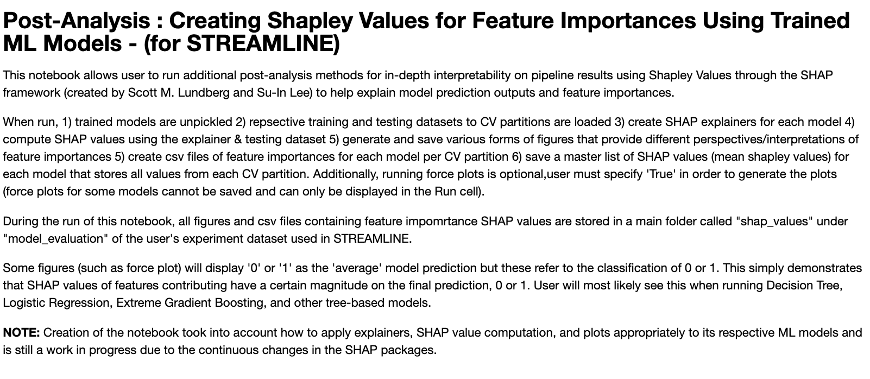
Get to know the code

Slide 46
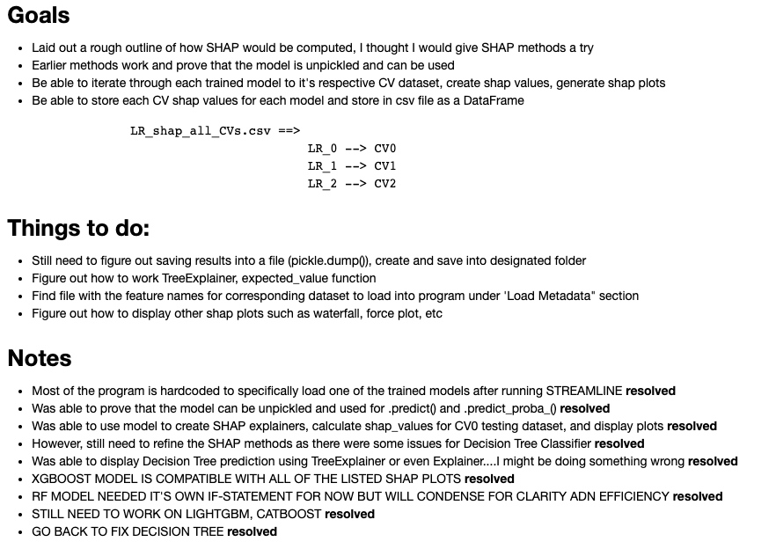
Get to know the code
Goals/Vision
Create a comprehensive SHAP Jupyter Notebook that can handle loading/using data and objects from STREAMLINE
Start out simple → build on foundation through unit testing blocks of code
End goal is to be able to create values and figures & store them in a designated folder for each trained model used in STREAMLINE

Slide 47
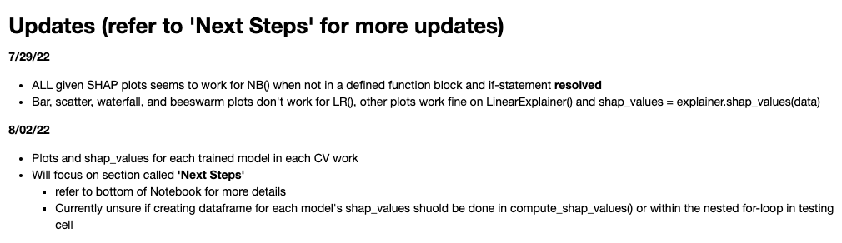
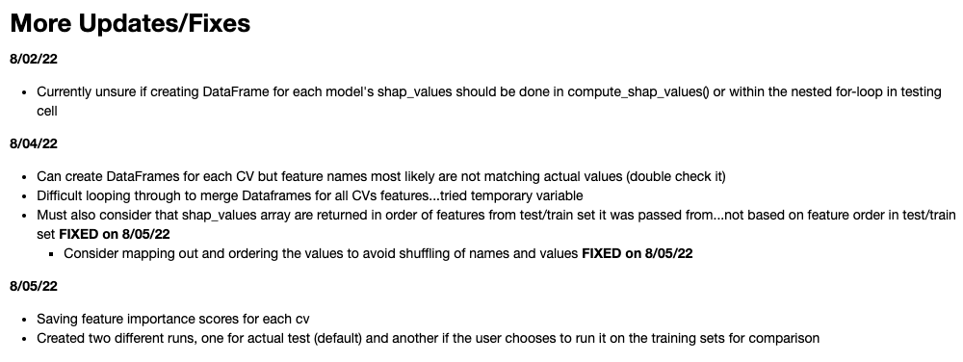
Get to know the code
Tracking Progress
Continuously update these sections to keep track of issues/challenges I’ve encountered & what I’ve been able to resolve

Slide 48
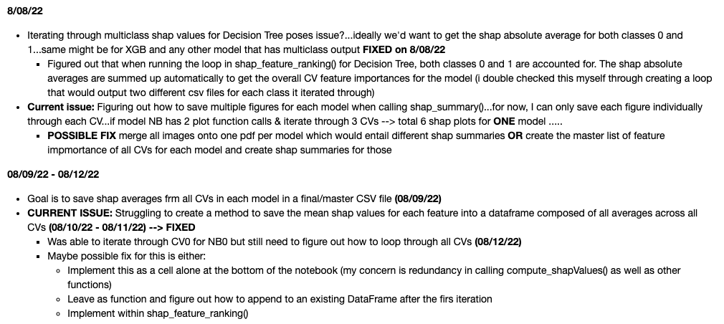
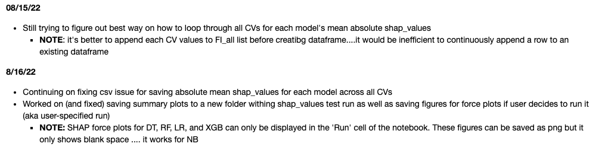
Get to know the code
Tracking Progress (cont.)
Changes to the notebook continue to ensure organization of code as well as performance
Certainly, there are better ways to write lines of code in this notebook

Slide 49
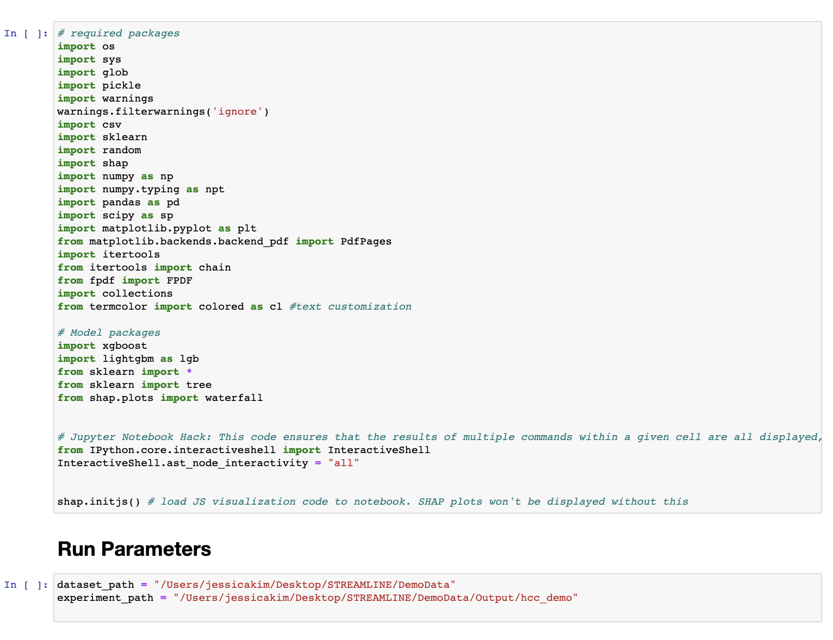
The Process: Setting Up Software Packages
Setting up
Loading necessary packages and run parameters
Run parameters
experiment_path refers to the file path that the notebook will be directed to → access correct files

Slide 50
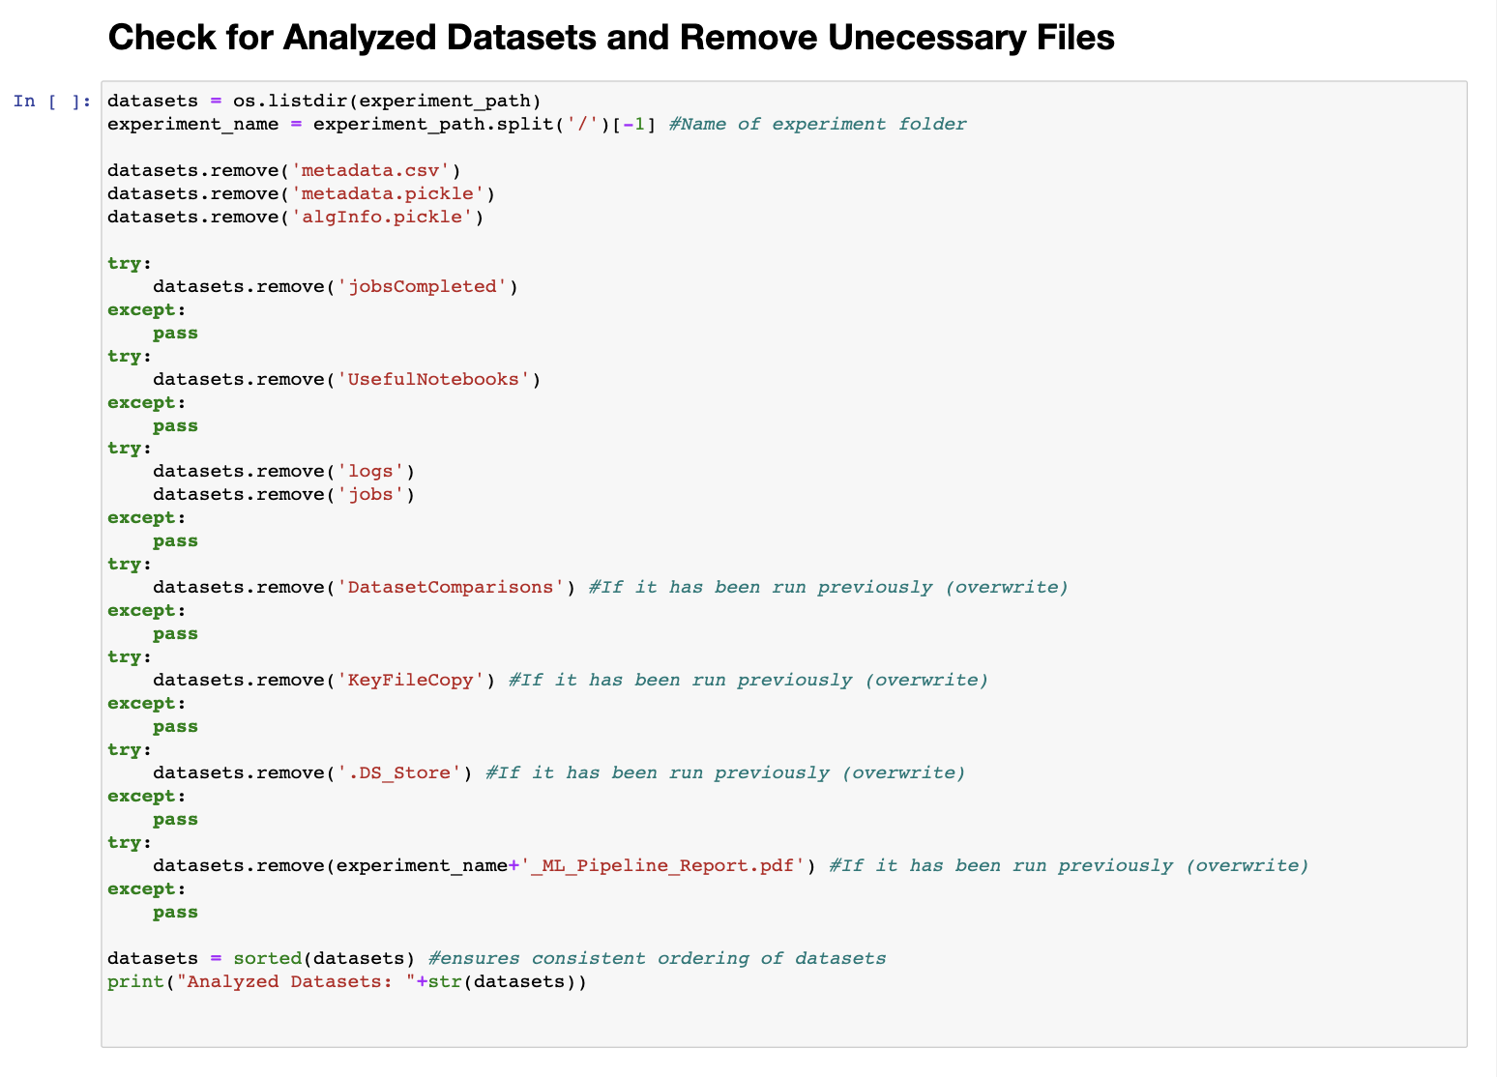
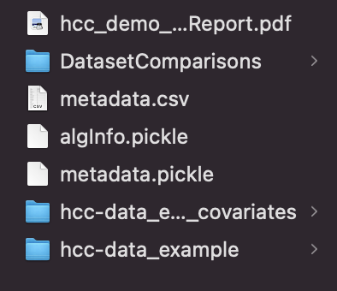
The Process: Setting Up Variables & Datasets
Setting up (cont.)
Check for unnecessary files for easy access to correct analyzed dataset files

Slide 51
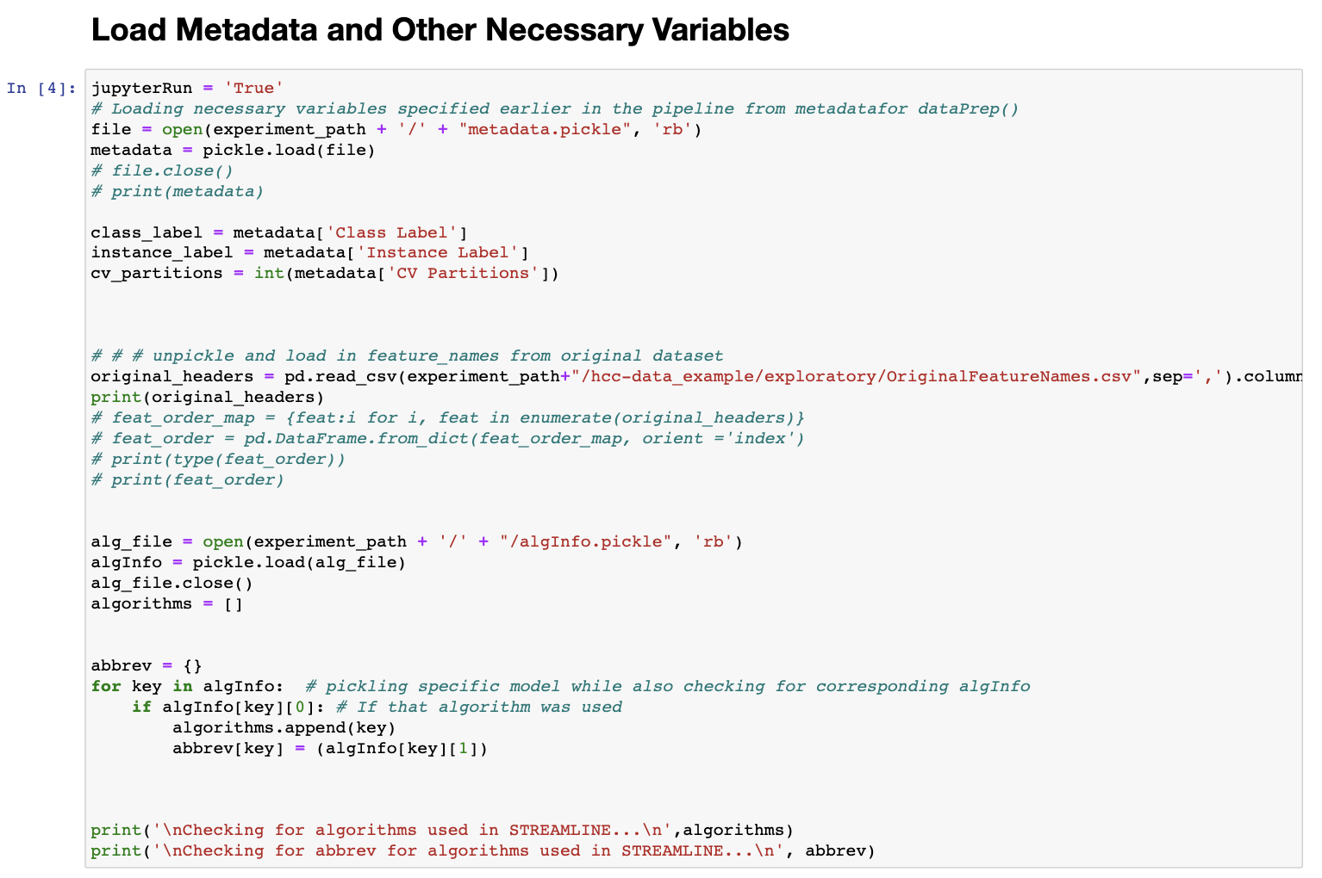
The Process: Setting Up Variables & Datasets (cont.)
Setting up (cont.)
Opens file called ‘metadata.pickle’ to access all metrics and information about models & datasets from STREAMLINE run
‘algInfo.pickle’ : information about all algorithms used during STREAMLINE
Saves abbreviated name of each trained model (e.g. Naïve Bayes → ‘NB’) into an algorithms [ ] list

Slide 52
The Process: Setting Up Variables & Datasets (cont.)
Setting up (cont.)
Abbreviated names for trained models are used for comparison later in the code to correctly assign functions to the respective model
Feature names from original dataset (dataset before CV partitioning in STREAMLINE into train/test sets)
Later used to create master list of all features for each trained model

Slide 53
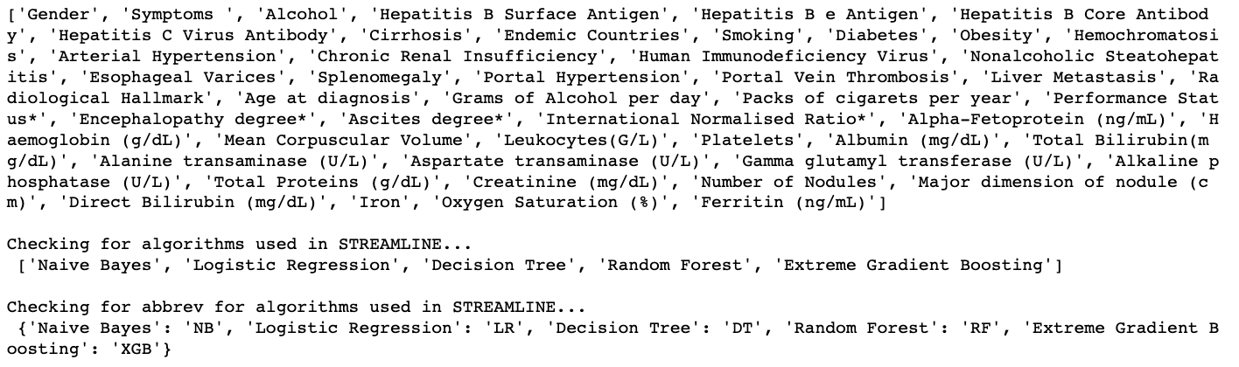
Example of Output For Setting Up
Printed list of all features from original dataset
Print statement to double-check for all trained models from STREAMLINE
Print statement to check algorithms [ ] list for abbreviated model names

Slide 54
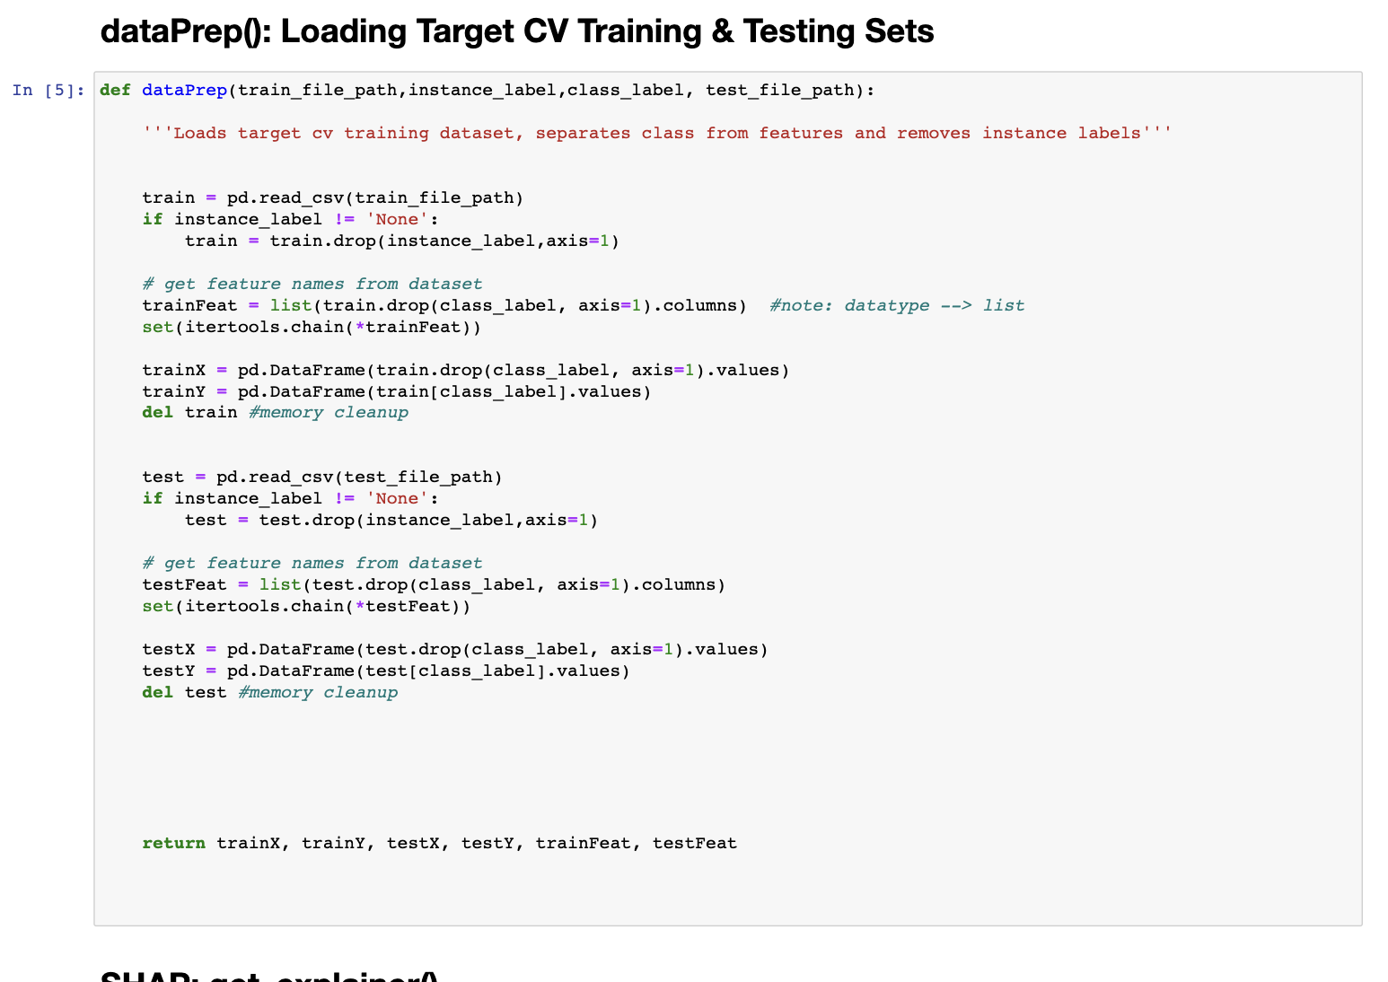
The Process: Loading CV Datasets
CV Training & Testing Datasets
Data_prep() loads each training & testing dataset for each CV partition used during STREAMLINE
Removes ‘Class ID’ and ‘Instance ID’ from datasets (irrelevant features)
Returns respective trainX & testX datasets as well as features sets for each

Slide 55
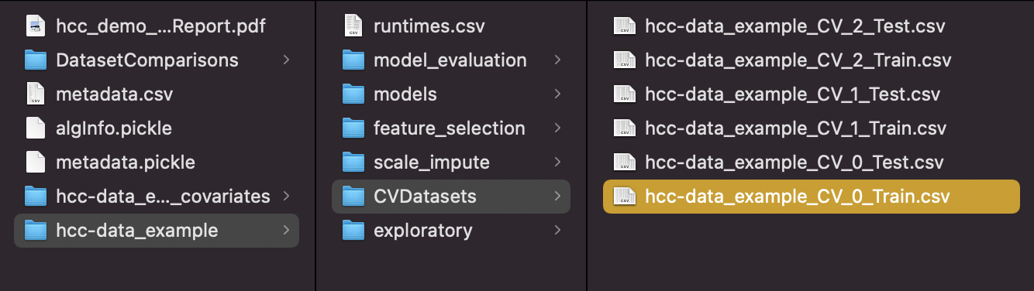
The Process: Loading CV Datasets (cont.)
Experiment_path is hcc-data_example file
All CV datasets from STREAMLINE run(split from original dataset) stored under this folder
Number will vary depending on how many CV partitions the user wanted
This example uses 3 full CV partitions
→ 6 sets total
→ Train & test set for each partition
All CV datasets from STREAMLINE run(split from original dataset) stored under this folder

Slide 56
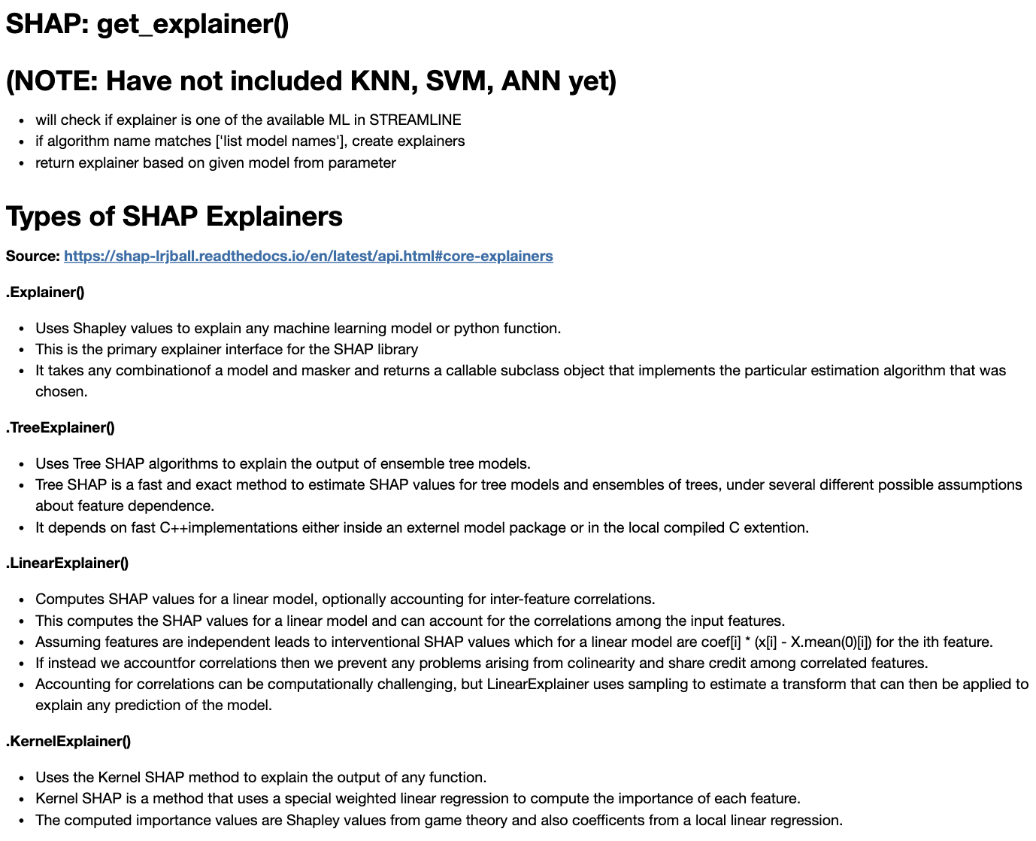
Using SHAP Explainers
Explainers
Info section is included help any user gain a better understanding of the purpose and application of SHAP explainers
4 main explainers used to account for compatibility with trained models

Slide 57
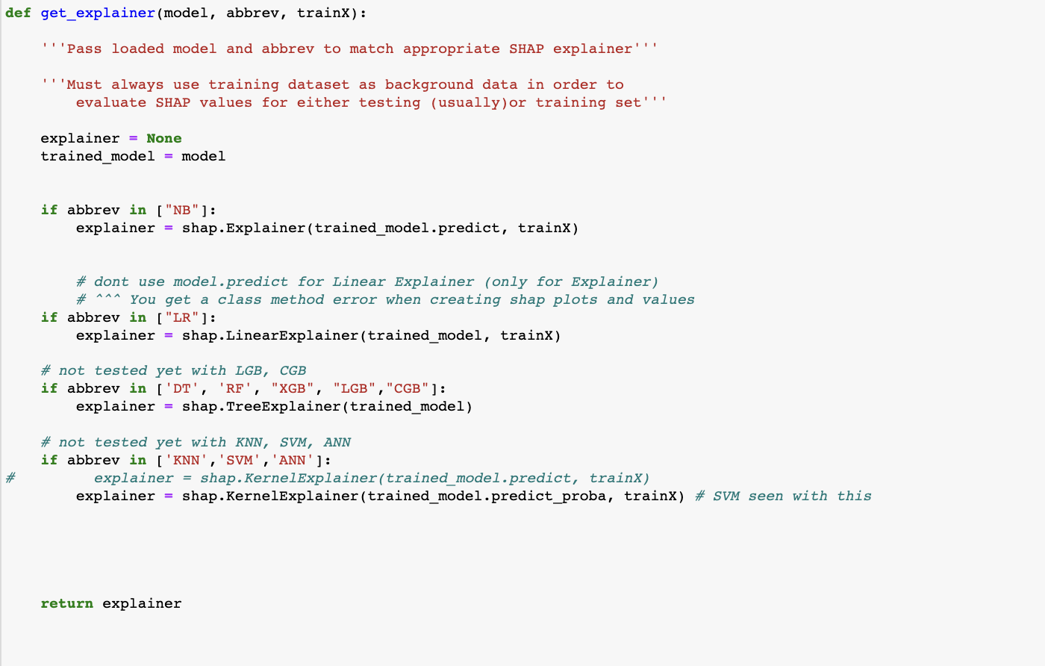
Using SHAP Explainers (cont.)
About def get_explainer()
Model abbreviation passed into function as ‘abbrev’
Abbrev must match listed abbreviation (abbrev: ‘LR = [‘LR]
This helps return the correct Explainer object for the trained model we are iterating on
Trained model and training dataset are also used for the creation of Explainer objects

Slide 58
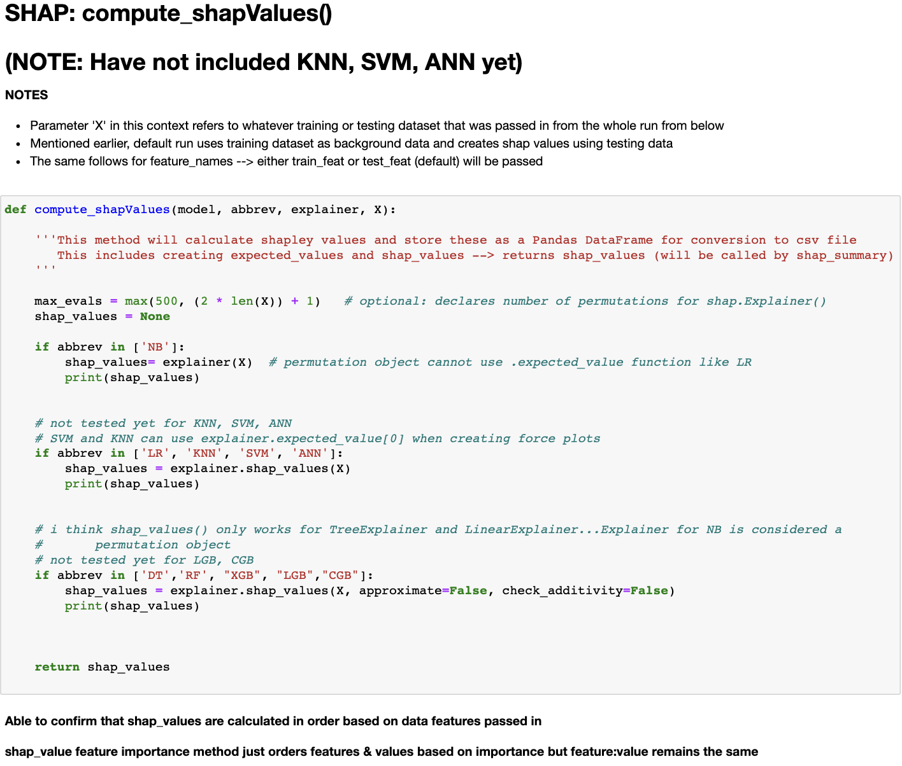
Computing SHAP Values
About compute_shapValues()
Function can be used when running notebook on testing dataset (default) or training (optional)
Computes SHAP values using Explainer object created from previous function, testX dataset, & abbrev
.shap_values() works for most models & returns 2D array of values (does not work for Naïve Bayes Classifier)

Slide 59
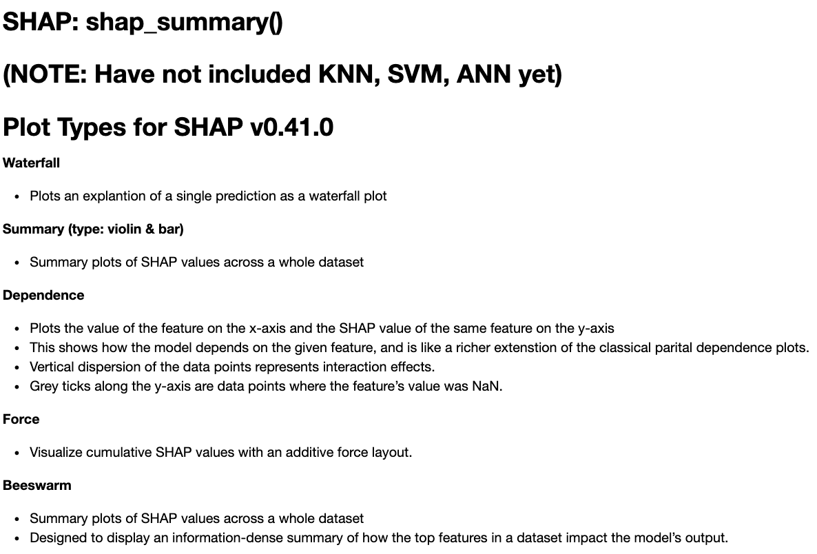
Saving SHAP Summary Figures
Function can be used when running notebook on testing dataset (default) or training (optional)
Different summarization figures are provided to take variability of user’s interpretation into consideration
Based on most recent version of SHAP package (version 0.41)

Slide 60
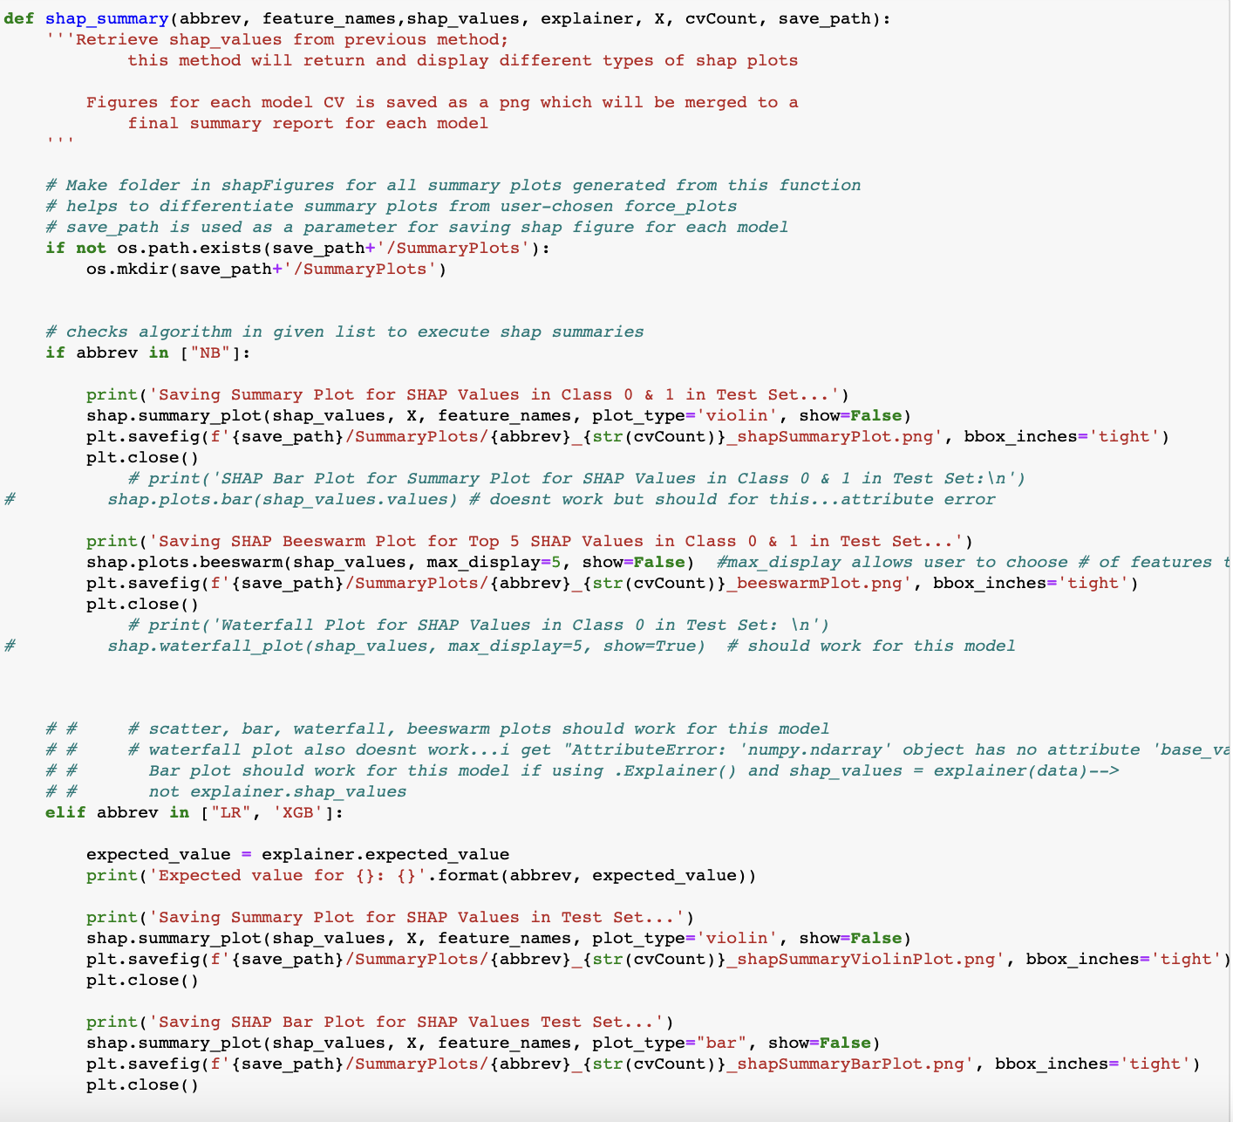
Saving SHAP Summary Figures (cont.)
About shap_summary()
Certain SHAP figures work for certain models and Explainer objects
Creates summary figures using Explainer object, abbrev, feature names, and SHAP values for given trained model per CV
Saves figures using a file path called ‘save_path’

Slide 61
Saving SHAP Summary Figures (cont.)
About explainer.expected_value()
Only works for certain models
It is the model’s ”expected” values over the whole dataset
What a model would predict without the knowledge of the data
In binary classification → classified outcome into 0 or 1
Keep in mind that one model per CV count is passed into these functions
Function provides various types of summary figures that would seem interpretable, not all may be intuitive
Interpretability differs from user to user
Example: NB0 → NB_0_shapSummaryPlot.png

Slide 62
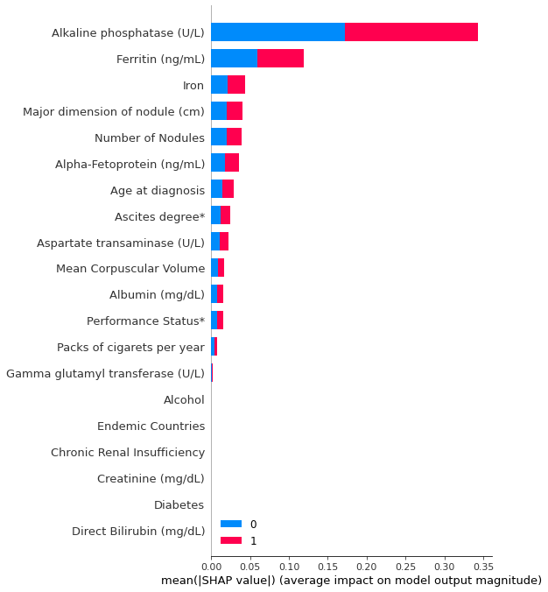
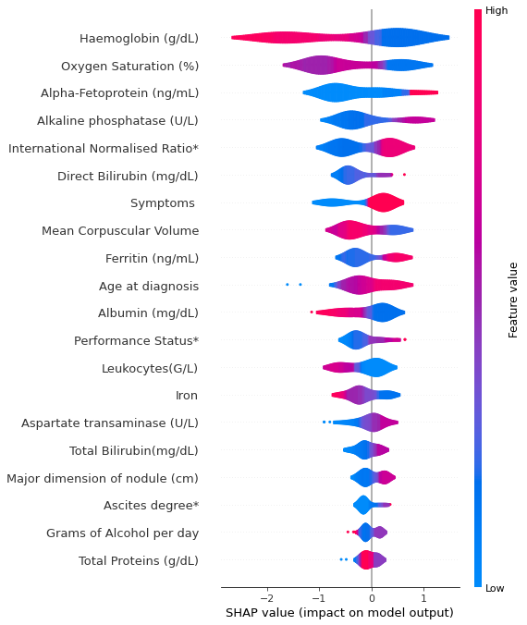
Examples of Summary Figures
← CV0 Random Forest Bar Summary Bar Plot
CV0 Extreme Gradient Boosting Summary Violin Plot →

Slide 63
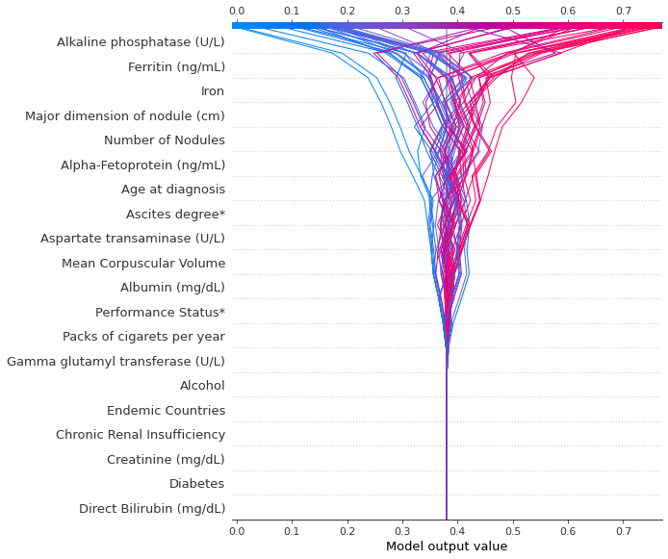
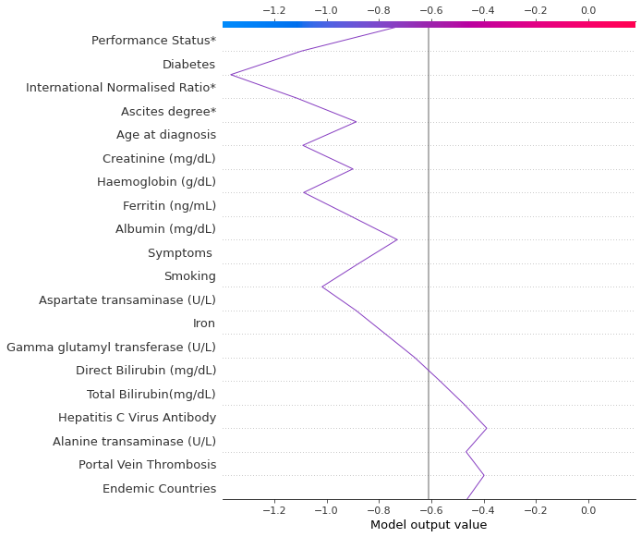
Examples of Summary Figures (cont.)
← CV2 Random Forest Decision Plot
CV1 Logistic Regression Single Prediction Decision Plot →

Slide 64
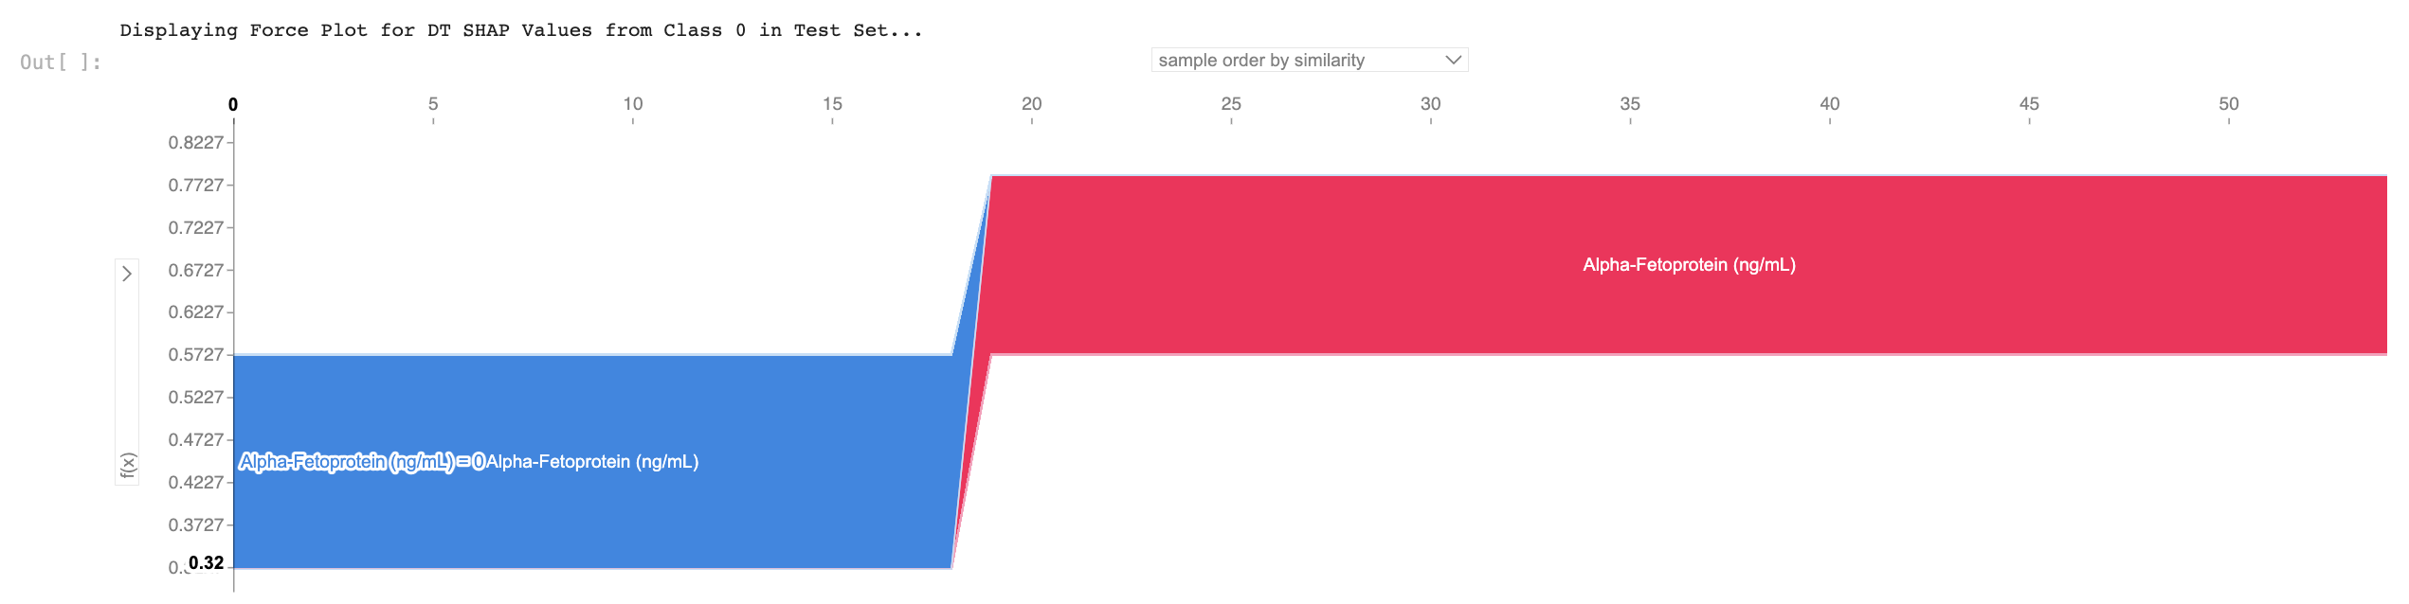
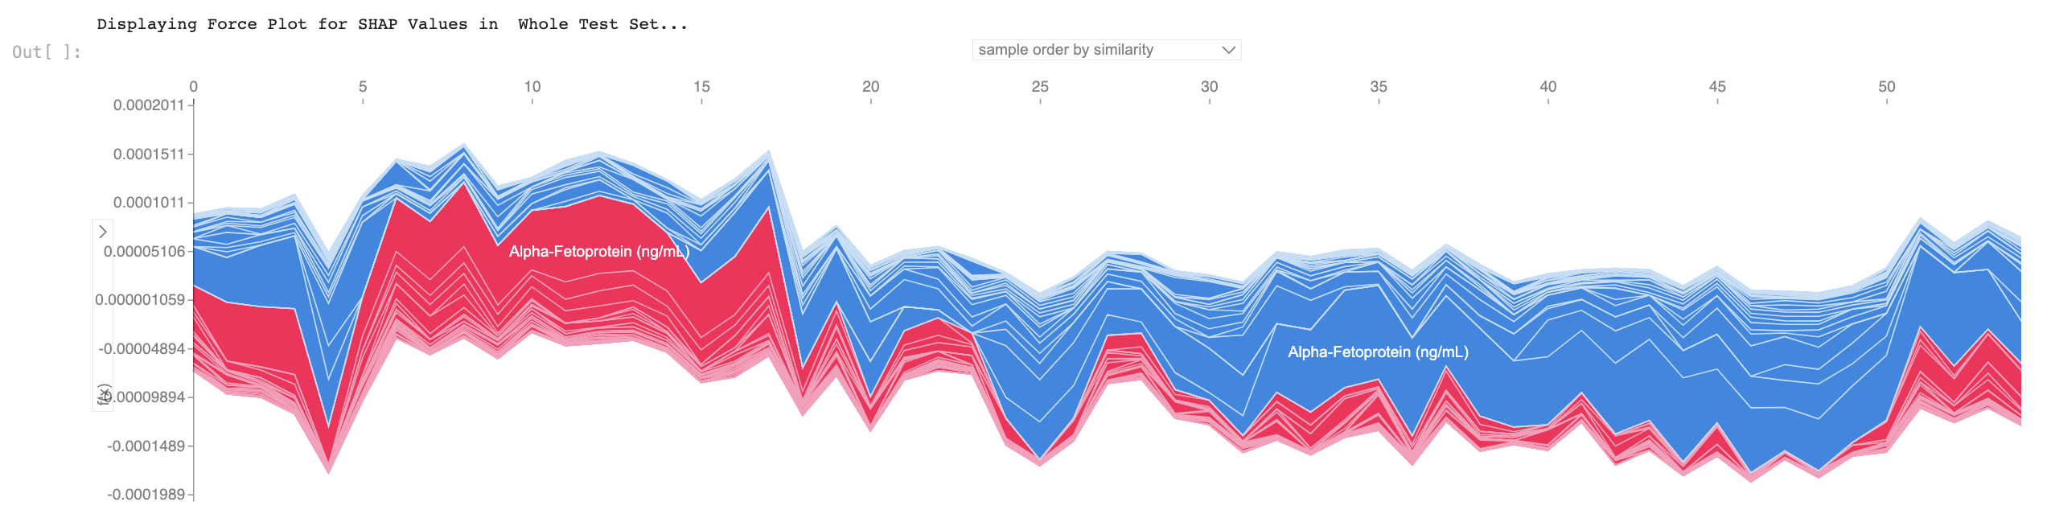
Examples of SHAP Force Plots
Force plots will display differently from model to model
We can either create force plots for a single prediction or for the whole dataset
However, force plots for single prediction or whole dataset may not work for some models

Slide 65
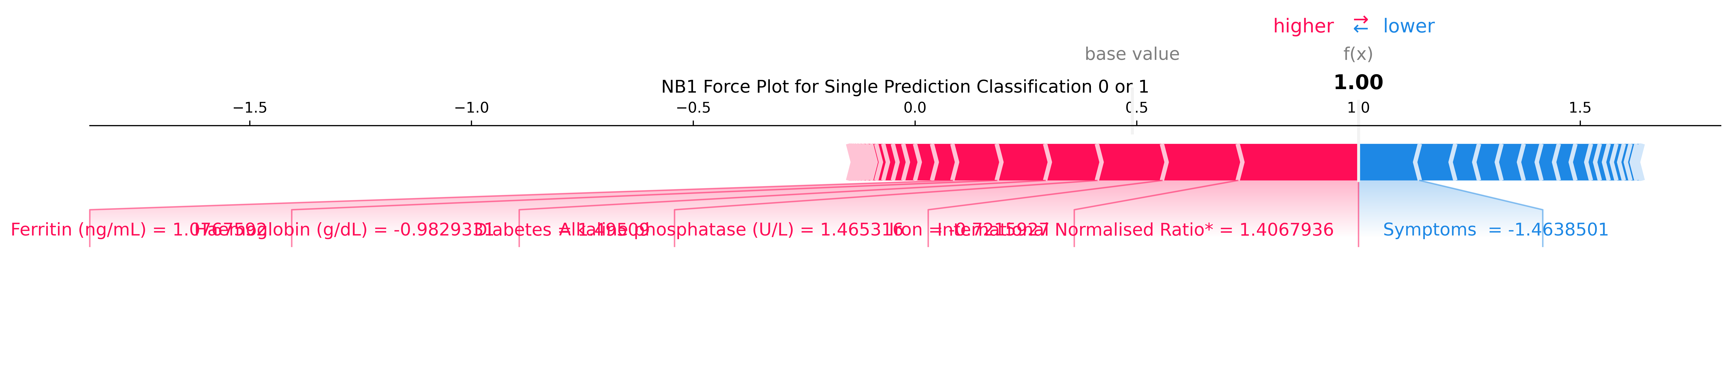
Examples of SHAP Force Plots (cont.)
Depending on the format of the force plot….
‘Blue’ refers to how much the feature decreased the probability
‘Red’ refers to how much the feature increased the probability (greater influence)
Larger bar/coverage indicates higher magnitude (greater impact on prediction)

Slide 66
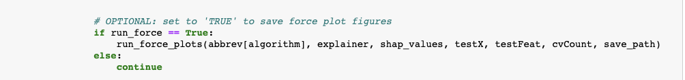
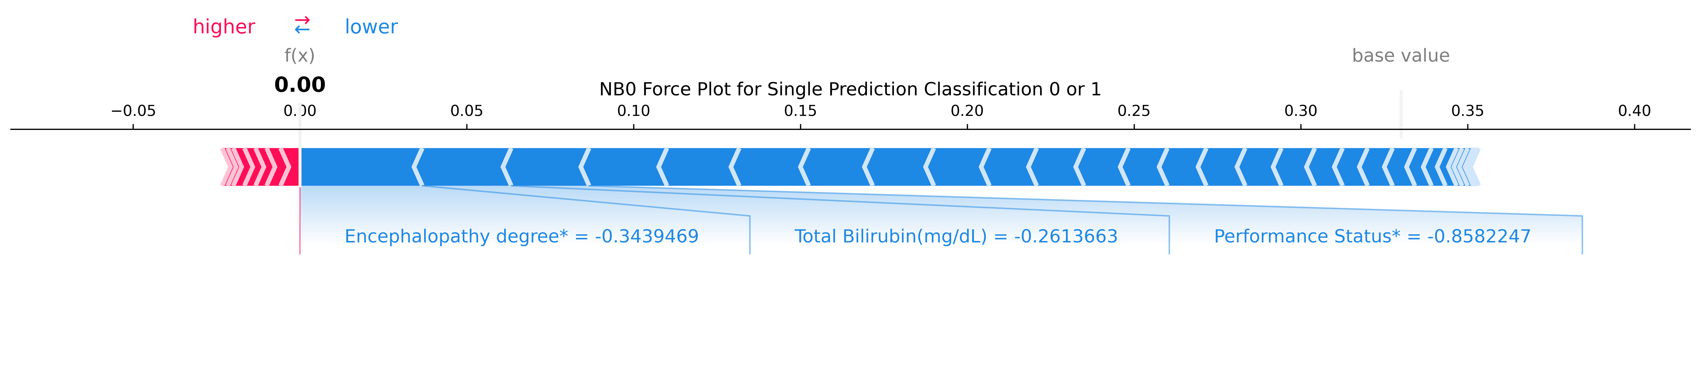
How My SHAP Code Creates Force Plots
‘Run’ calls ‘run_force_plots()’
‘run_force_plots’ saves force plot figures for each model per CV
Returns whole force plots for certain models can only be displayed in ‘Run’ output cell
Force plot of a single prediction for Naïve Bayes() in CV0 and CV1 →

Slide 67
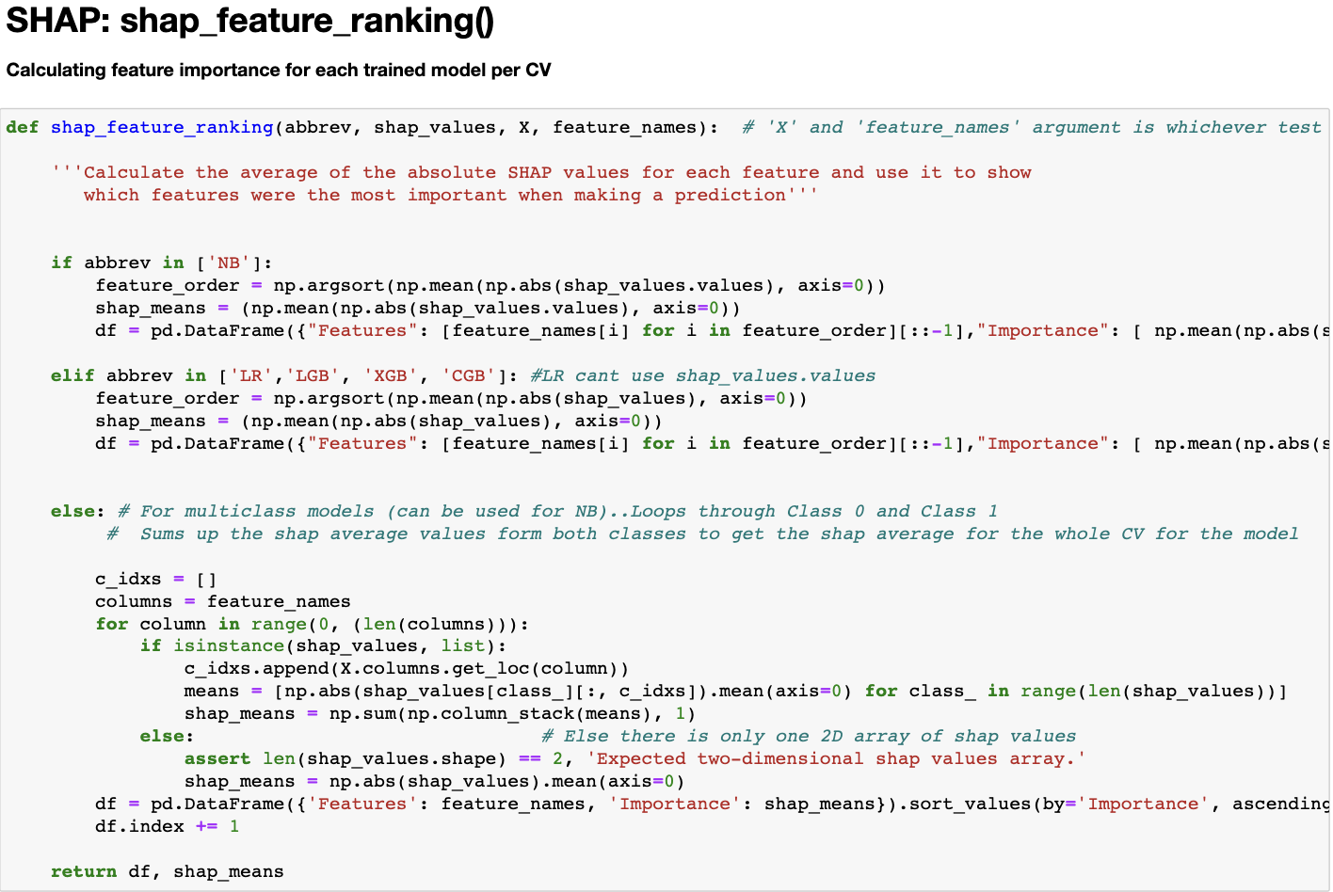
Computing SHAP Feature Ranking/Importance
About shap_feature_ranking()
Parameters passed: abbrev, shap_values, testX dataset, & testX feature names
Match abbrev to listed abbreviations
Not all models follow the same computation method
SHAP values are averaged out and sorted out before mapped with respective feature names
Returns feature importance dataframe (think Excel sheet) and ‘shap_means’ which is later used to create the master list

Slide 68
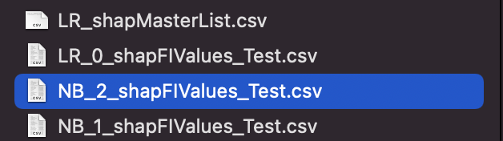
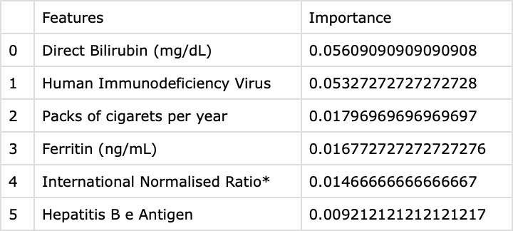
Computing SHAP Feature Ranking/Importance (cont.)
About shap_feature_ranking() (cont.)
SHAP values are averaged out and sorted out before mapped with respective feature names
Values w/ features sorted based on most to least important
Returns feature importance dataframe (think Excel sheet) and ‘shap_means’ which is later used to create the master list
Returned dataframe is converted into a ‘.csv’ file as (e.g. ‘model_cvCount_shapFIValues.csv’) in case of future uses
This process is completed for each model per CV

Slide 69
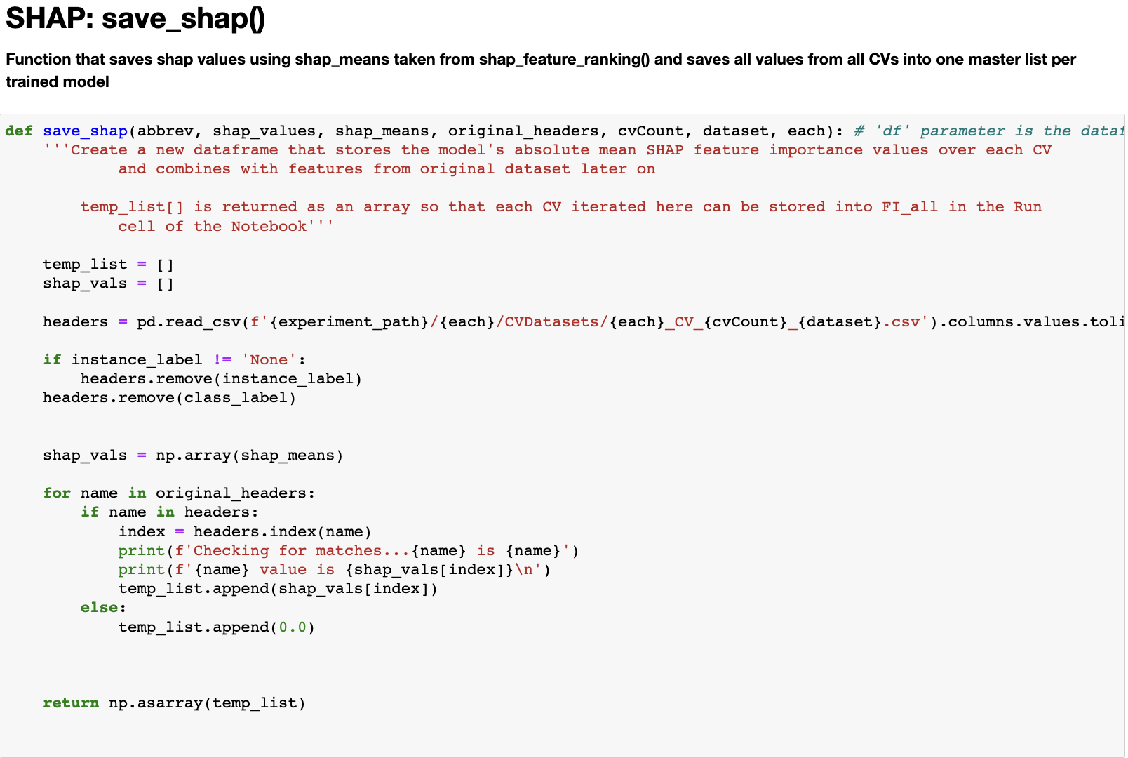
Saving SHAP Values
About save_shap()
Parameters passed: abbrev, shap_values, shap_means, original feature names, cvCount, type of dataset (type ‘str’) and experiment dataset (‘hcc-data_example)
temp_list [ ] to stores all features/missing features with respective values
Shap_vals [ ] to reshape shap_means as a NumPy array for easy appending values & names to temp_list [ ]
Returns full list of features & missing features values

Slide 70
Saving SHAP Values (cont.)
About save_shap() (cont.)
‘headers’ uses Pandas function ‘.read_csv’ to read appropriate dataset to grab feature names
Uses ‘each’ (hcc-data_example) and ‘cvCount’ (0,1, or 2) to navigate correct file path
If-statement removes ‘Class_ID’ and ‘Instance ID’ labels if needed
Reshape shap_means in a structured NumPy array and store in shap_vals [ ]

Slide 71
Saving SHAP Values (cont.)
About save_shap() (cont.)
For-loop iterates through each name in original headers
Contains if-else statement to check if the name matches in ‘headers’ as it does in original feature names
Creates variable ‘index’ to store the index value (number) of where the name is
Create print statements to double-check values with correct feature name

Slide 72
Saving SHAP Values (cont.)
About save_shap() (cont.)
Shap_vals[index]’ → find index in shap_vals list based on index of headers
Append temp_list with values in order
Else statement executes if feature was not found in headers
Append value 0.0 for missing features
Returns temp_list [ ] as a NumPy array

Slide 73
Checkpoint!
AMAZING! You’ve gotten through the foundational materials and got to know my code a little more!
Lots of information and I bet you must be confused. Sure, we went over different functions I’ve created but how does it all fit together?
These next slides will go over how the code runs using all of the functions and provides diagrams/images to show you →

Slide 74
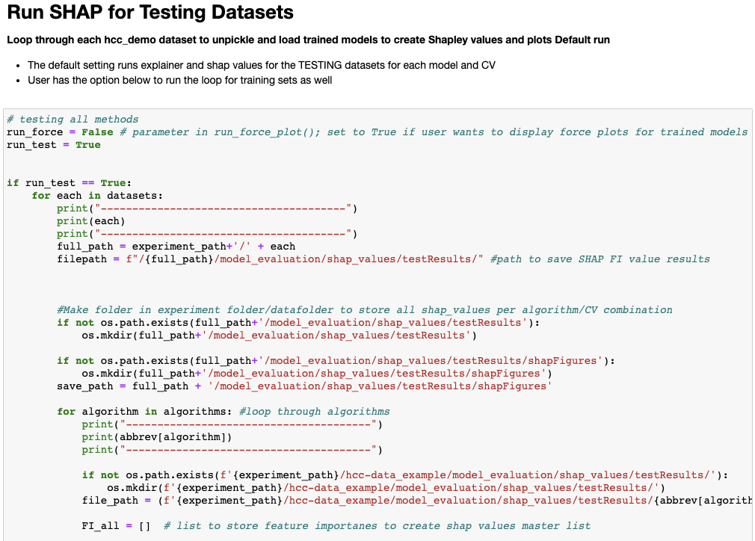
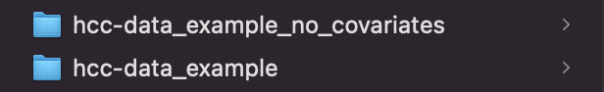
Run Jupyter for Testing Datasets: First For-Loop
Running SHAP on Test Datasets (default)
Set ‘run_test = True’ initiates iterative nested loop to perform all data prep and SHAP functions that were previously covered
‘run_force’ is by default ‘False’ but can be set ‘True’ if user wants to create SHAP force plots for the run
Outer-most loop in image will navigate to the correct analyzed datasets
Create a path variable which will be used later for saving SHAP feature importance files

Slide 75
Run Jupyter for Testing Datasets: 2nd For-Loop
The ‘testResults’ folder contains SHAP FI files, SHAP master list, and SHAP figures
2nd inner loop iterates through each algorithm in algorithms [] list
Creates ‘file_path’ which is done for each model after each iteration
Create an empty list called ‘FI_all [ ]’ that will be used to hold the returned temp_list [ ] from ‘save_shap()’

Slide 76
Run Jupyter for Testing Datasets: 2nd For-Loop (cont.)
First two loops: setting up paths & folders and creating empty variables for the inner-most loop that does all of the calculations
Inner-loop breaks, code moves back to the 2nd loops to use next algorithm → goes back into inner-most loop again
Create new directories to store new folders specifically for the run on the Test dataset

Slide 77
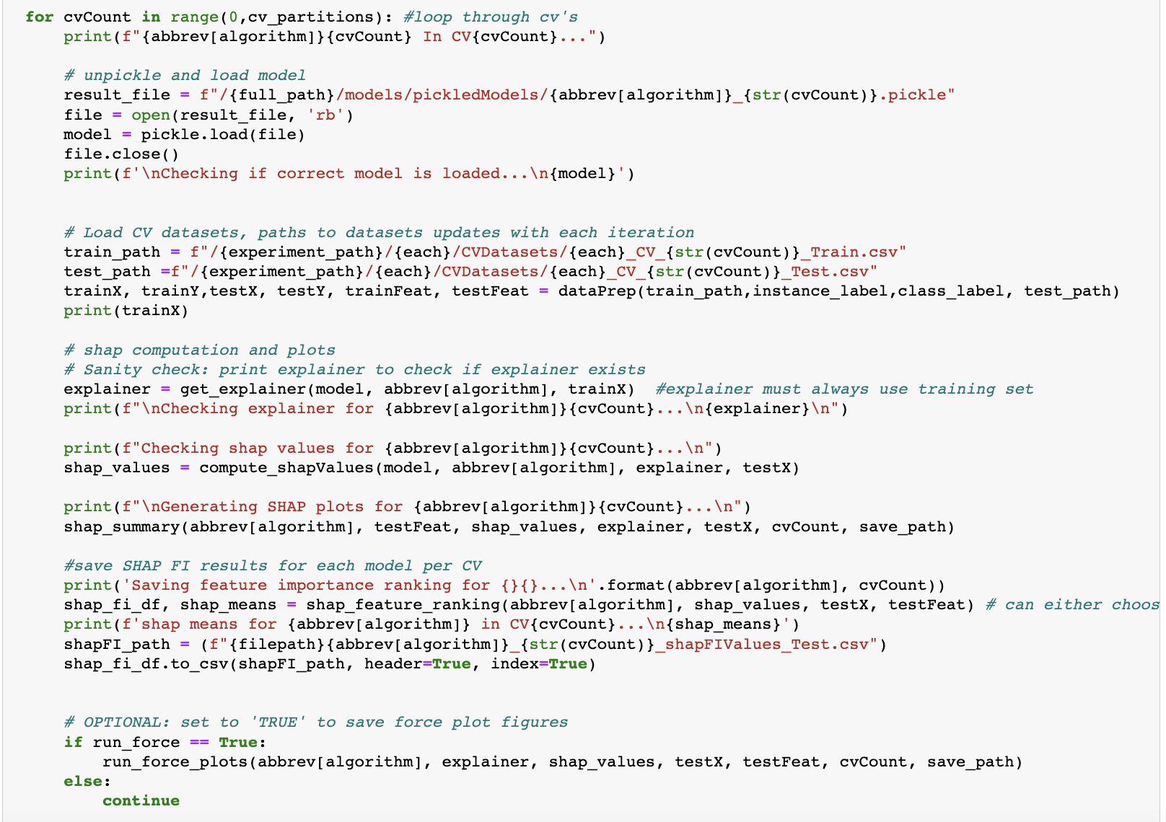
Run Jupyter for Testing Datasets: 3rd For-Loop
3rd (inner-most for-loop) iterates through all CVs to:
Load correct model
Load train/test sets to create test/train x and y variables
Create Explainer object
Generate SHAP values
Save SHAP figures
Save SHAP feature importance csv files for each model per CV
Save/Display SHAP force plots if user-specified

Slide 78
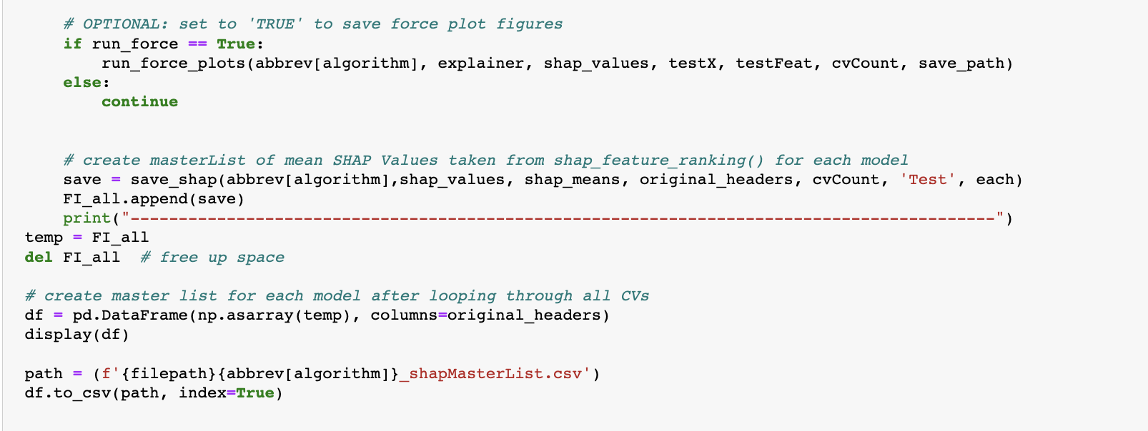
Run Jupyter for Testing Datasets: 3rd For-Loop (cont.)
Save all SHAP values in a master list for each trained model
Parameters passed for the function are:
Abbrev
Shap_values
Shap_means
Original dataset feature names
String datatype to identify datasets with keyword ‘Test’
Analyzed dataset you are in (‘each’ variable)
1
Done in 3rd loop after saving SHAP feature importance values and force plots

Slide 79
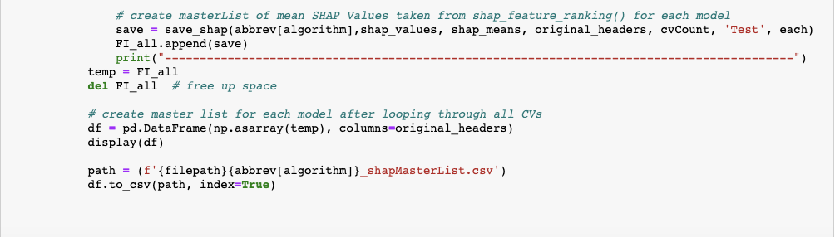
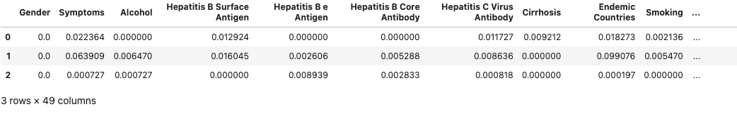
Run Jupyter for Testing Datasets: 3rd For-Loop (cont.)
Create a new dataframe (similar to a Google Spreadsheet) using the temp [ ] that stores all SHAP values in the order respective to the original headers
3
This is one trained model with SHAP values from all CVs (0-2) displayed in output cell when running the code

Slide 80
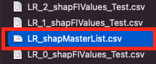
Run Jupyter for Testing Datasets: 3rd For-Loop (cont.)
4
Create a path variable to use as an “address” to tell the code to store the new file in a specific folder
This is done for each trained model for all CVs and should look like a table

Slide 81
Run Jupyter for Testing Datasets: 3rd For-Loop (cont.)
Returns appended ‘temp_list’ that stores all features from original dataset & testing dataset with respective SHAP values...
Temporary list called ‘FI_all [ ]’ serves as a disposable empty list which saves the returned list from ‘save_shap()’
2

Slide 82
End of Run Jupyter for Testing Datasets: Example of SHAP Master List Output
The number of rows represents # of CVs that were run during STREAMLINE
Each feature will have different SHAP values for each partition
Unused or missing features in each CV will have the value of 0.0
Table of features and values are ordered based on features from original dataset instead of varying feature order from different CV datasets

Slide 83
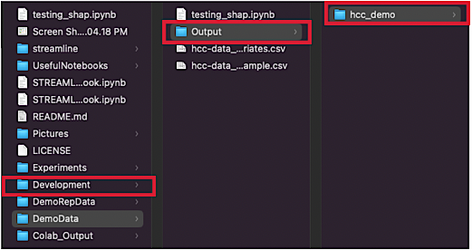

File Structure After Running STREAMLINE x SHAP
1: Starting folder
2:
STREAMLINE code opens ‘experiment_path’ folder and uses datasets
Results of STREAMLINE stored in ‘Output’ folder

Slide 84

File Structure After Running STREAMLINE x SHAP (cont.)
Datasets that are analyzed during STREAMLINE
Contains folder for SHAP evaluation results
3
Contains train/test CV datasets that were partitioned during STREAMLINE

Slide 85

File Structure After Running STREAMLINE x SHAP (cont.)
Main folder where all SHAP results from the notebook are stored
4
testResults: stores all new files and figures from running notebook on testing datasets (default)
trainResults: only created when user specifies in notebook to run on training datasets

Slide 86

File Structure After Running STREAMLINE x SHAP (cont.)
5
All SHAP values master list for each trained model
Figures separated into two different folders since force plots are optional in the notebook
Most summary figures by default are stored in ‘SummaryPlots’
All figures for each model over all CVs stored here

Slide 87
Final Thoughts
I’m a Health Administration major with a minor in Computer Science so I don’t have too much experience and knowledge about Data Science and Machine Learning. I’d have to say as much as a challenge this has been for the past 10 weeks, it was worth the experience.
It’s been quite the journey seeing how many issues I’ve logged down when working on the code but seeing how I’ve been able to resolve most gave me more confidence to continue working on my coding skills
Being introduced to ML is like being thrown into the deep-end of a pool. However difficult it was to do my best to catch up on what my mentor’s project was about to work with it. It definitely pushed me to do my absolute best in something so new to me

Slide 88
Final Thoughts
This experience gave me a new career path(s) to consider and even though I may have some catching up to do, I really loved what I did. I’ve struggled for the past 2 years wondering what I could possibly do with my background and where it can be applied
This project helped me realize what I can and can’t do except the ‘can’t do’ attitude came from me not knowing I could do more. So it was nice pushing my self to do more to keep up with the pace of things
The code I created has code from my mentor’s STREAMLINE code (just to keep things consistent) but the challenging part was creating the SHAP code for the models from how I’ve seen other people apply it to their datasets. Not everything was applicable to what the code I was trying to hash out.

Slide 89
Supplemental Materials & Resources
The remaining slides are supplemental materials relevant to coding and are optional to look at:
Understanding mechanics of for-loops/nested for-loops for my project SHAP
Resources for specific topics covered briefly in this presentation
Published papers about SHAP implementation

Slide 90
How For-Loops Work in My SHAP Code
For each in dataset:
* Access datasets used in STREAMLINE
* Usually starts with ‘hcc-data_example’ before moving
onto additional datasets
For algorithm in algorithms:
* start with first algorithm in algorithms [ ] list
* move to next algorithm when inner-loop finishes
For cvCount in range(0, cv_partitions):
1

Slide 91
How For-Loops Work in My SHAP Code (cont.)
For each in dataset:
* Access datasets used in STREAMLINE
* Usually starts with ‘hcc-data_example’ before moving
onto additional datasets
For algorithm in algorithms:
* start with first algorithm in algorithms [ ] list
* move to next algorithm when inner-loop finishes
For cvCount in range(0, cv_partitions):
1
2

Slide 92

How For-Loops Work in My SHAP Code (cont.)
For each in dataset:
* Access datasets used in STREAMLINE
* Usually starts with ‘hcc-data_example’ before moving
onto additional datasets
For algorithm in algorithms:
* start with first algorithm in algorithms [ ] list
* move to next algorithm when inner-loop finishes
For cvCount in range(0, cv_partitions):
3
Iterates 0, 1, & 2 → Break loop
3

Slide 93
How For-Loops Work in My SHAP Code (cont.)
For each in dataset:…
For algorithm in algorithms:…
For cvCount in range(0, cv_partitions):
3
Iterates 0, 1, & 2 → Break loop

Slide 94
How For-Loops Work in My SHAP Code (cont.)
Total # CV Partitions: 3
For cvCount in range (0, cv_partitions):
Translate → loop length is between 0 and total # of partitions (3)
What happens → Iterates 0, 1, and 2
Starts at cvCount = 0; CV0 for model_0, train_dataset_0, test_dataset0 → finish
Starts at cvCount = 1; CV1 for model_1, train_dataset_1, test_dataset_1 → finish
Starts at cvCount = 2; CV2 for model_2, train_dataset_2, test_dataset2 → break inner loop
Goes back into previous loop to iterate to next model (algorithm in algorithms [ ] list)
Starts at cvCount = 0; CV0 for nextModel_0….
Starts at cvCount = 1; CV1 for nextModel_1….
Starts at cvCount = 2; CV2 for nextModel_2… → break inner loop

Slide 95
How For-Loops Work in My SHAP Code (cont.)
4: Once inner-most loop breaks, code moves back into the second loop to iterate to the next algorithm in algorithms [ ] list & enters inner-most loop again
For each in dataset:
For algorithm in algorithms:
For cvCount in range(0, cv_partitions):
4

Slide 96
How For-Loops Work in My SHAP Code (cont.)
5 : Only happens once 2nd inner loop iterates through all algorithms in algorithms [ ] list
5
For each in dataset:
For algorithm in algorithms:
For cvCount in range(0, cv_partitions):

Slide 97
How For-Loops Work in My SHAP Code (cont.)
5
For each in dataset:
* Access datasets used in STREAMLINE
* Usually starts with ‘hcc-data_example’ before moving
onto additional datasets
For algorithm in algorithms:
* start with first algorithm in algorithms [ ] list
* move to next algorithm when inner-loop finishes
For cvCount in range(0, cv_partitions):
3
1
4
2
Iterates 0, 1, & 2 → Break loop
3

Slide 98
Supplemental Materials & Resources
Resources for Machine Learning:
An introduction to Machine Learning. https://www.geeksforgeeks.org/introduction-machine-learning/
Hands-on Guide to Interpret Machine Learning with SHAP. Analytics India Magazine. https://analyticsindiamag.com/hands-on-guide-to-interpret-machine-learning-with-shap/#:%7E:text=SHAP%20works%20well%20with%20any,%2C%20lightgbm%2C%20and%20decision%20trees.
Resources for Shapley Values:
The right way to compute your Shapley Values - Towards Data Science. Medium. Retrieved August 26, 2022, from https://towardsdatascience.com/the-right-way-to-compute-your-shapley-values-cfea30509254
Resources for SHAP:
Iris classification with scikit-learn — SHAP latest documentation. SHAP. https://shap.readthedocs.io/en/latest/example_notebooks/tabular_examples/model_agnostic/Iris%20classification%20with%20scikit-learn.html
How to understand your customers and interpret a black box model. Medium. https://aigerimshopenova.medium.com/random-forest-classifier-and-shap-how-to-understand-your-customers-and-interpret-a-black-box-model-6166d86820d9
SHAP Part 2: Kernel SHAP - Analytics Vidhya. Medium. https://medium.com/analytics-vidhya/shap-part-2-kernel-shap-3c11e7a971b1
Scikit, No Tears 0.0.1 documentation. (n.d.). SHAP. https://learn-scikit.oneoffcoder.com/shap.html
Published papers about SHAP implementation
A Unified Approach to Interpreting Model Predictions. Retrieved from doi:10.48550/ARXIV.1705.07874.
Explainable AI for Trees: From Local Explanations to Global Understanding. doi:10.48550/ARXIV.1905.04610
SHAP and LIME: An Evaluation of Discriminative Power in Credit Risk. Front Artif Intell. 2021 Sep 17;4:752558. doi: 10.3389/frai.2021.752558. PMID: 34604738; PMCID: PMC8484963.

Slide 99

Supplemental Materials & Resources
Additional learning resources and materials can be found on my GitHub repository for this internship project at this link:
https://github.com/nezuko51/Summer-2022-Internship-Documentation-and-Resources

Slide 100
References
Chow, J. (2022, January 11). Shapley Values – A Gentle Introduction. H2O.Ai. https://h2o.ai/blog/shapley-values-a-gentle-introduction/
GeeksforGeeks. (2022, August 23). An introduction to Machine Learning. https://www.geeksforgeeks.org/introduction-machine-learning/
Gopinath, D. (2022, January 4). The Shapley Value for ML Models - Towards Data Science. Medium. Retrieved August 26, 2022, from https://towardsdatascience.com/the-shapley-value-for-ml-models-f1100bff78d1
Lee Lab. (n.d.). Google Sites. Retrieved August 26, 2022, from https://sites.google.com/a/cs.washington.edu/suinlee/about-the-pi
Lundberg, S. (2018). SHAP. SHAP. Retrieved July 7, 2022, from https://shap.readthedocs.io/en/latest/api.html#explainers
Lundberg, S. (2018). SHAP: Explanation. SHAP. Retrieved July 7, 2022, from https://shap.readthedocs.io/en/latest/api.html#explainers
Molnar, C. (2022, July 12). 9.5 Shapley Values | Interpretable Machine Learning. GitHub. Retrieved August 26, 2022, from https://christophm.github.io/interpretable-ml-book/shapley.html
Scott Lundberg: Biography. (n.d.). Scott Lundberg. Retrieved August 26, 2022, from https://scottlundberg.com
7. SHAP — Scikit, No Tears 0.0.1 documentation. (n.d.). SHAP. https://learn-scikit.oneoffcoder.com/shap.html
Sukumar, R. (2021, December 14). SHAP Part 2: Kernel SHAP - Analytics Vidhya. Medium. https://medium.com/analytics-vidhya/shap-part-2-kernel-shap-3c11e7a971b1

Slide 101
References
Urbanowicz, R. (2022, June 28). What is Machine Learning? Demystifying Methods and Application | Cedars-Sinai [Video]. Youtube. https://www.youtube.com/watch?v=MhK2Jz36T5o&list=PLafPhSv1OSDdG2v8K2EsXPd0V7TTQVnT9
Urbanowicz, R., & Zhang, R.(2022). STREAMLINE: A Simple, Transparent, End-To-End Automated Machine Learning Pipeline. GitHub. Retrieved from https://github.com/UrbsLab/STREAMLINE#how-is-streamline-different-from-other-automl-tools.
Zlaoui, K. (2022, February 23). Interpretable Machine Learning using SHAP — theory and applications. Medium. https://towardsdatascience.com/interpretable-machine-learning-using-shap-theory-and-applications-26c12f7a7f1a

